Slide 1
Digital Storytelling
PREETI TYAGI

Slide 2
Welcome, Handbook & Assessments | SWAY Portfolio Origin of Storytelling | Art of Storytelling | Stories around us
Patterns in Stories | Commercial Storytelling | Digital Storytelling
Intellectual Property | Digital Story Experience
Dev-Digital Story Experience | Sound Editing | Video Editing
Showcase | Digital Story Experience
Photography | Videography | Intro-Welcome to Bath Spa University
Sound Editing | Video Editing | Dev-Welcome to Bath Spa University
Showcase | Welcome to Bath Spa University
Interactive Storytelling | Basic Twine Practice | DropBox | ImGur | Itch.io
A1 Development | Photoshop
A1 Development | Timelapse
A1 Development | Stop Motion
A1 Development | Submission
Showcase | Assessment 1
Bitsy Game
A2 development
A2 development | Submission
Showcase | Assessment 2
Session
Plan

Slide 3
Introduction

Slide 4
Digital Storytelling introduces a variety of media making techniques and approaches to interactivity that serve storytelling.
You receive a primer in digital media production, and explore a range of digital narratives (e.g. web-based stories, alternative reality games, animated explainer videos) that are designed to inform, persuade or entertain.
Module
Description

Slide 5
Your journey from a “consumer” to a “maker”.
From “Working” artifacts to “Wow” artifacts.
Exploration of the thought process, tools, skills, and techniques to achieve them
Contextualization of creative digital artifacts
Exposure to a wide range of tools and possibilities
Socio cultural context and impact of digital media
Exploration of your own interests, philosophy, style & voice
Exploring, practicing & evaluating the use of digital media in industrial, commercial and professional context
Module
Objectives

Slide 6
An interactive adaptation of a given narrative, developed in Twine.
Your task is to create an interactive, non-linear story based on a given narrative. Your project must contain text, images and hyperlinking and be compiled using the online storytelling platform, Twine.
The interactive story must take, as its starting point, one of the following fairy tales:
The Three Little Pigs
Jack and the Beanstalk
Little Red Riding Hood
Goldilocks and the Three Bears
Assessment 1
30%
Non Linear Story
Few great precedents
https://alleleeflores.itch.io/the-bakers-inn-the-inn-of-no-return
https://mayaamurao.itch.io/hansel-and-gretel
https://shxynez.itch.io/little-red
https://patrishao.itch.io/alice-in-wonderland

Slide 7
A collection of digital storytelling artefacts, presented via a blog. Each artefact is supported by a 300-word piece of reflective writing.
Your task is to compile a portfolio of several compulsory artefacts, which are to be made over the course of the Digital Storytelling module. Each artefact must be accompanied by a 300-word piece of reflective writing.
The complete portfolio must include (and not limited to) :
All class activities
Photoshop developments
A stop motion animation of 5-10 seconds. (group)
Bitsy game
A detailed list and format with requirements will be shared.
Assessment 2
70% Storytelling Portfolio
Few great precedents
https://sway.office.com/CeZSREeQM8DxAA9J
https://sway.office.com/iqAAeK7uEQy28SWX.
https://sway.office.com/DmXjlUjvxAT089aS?ref=Link
https://sway.office.com/1ZhjzLGAHgIzjJ7W?ref=Link
https://sway.office.com/gNuie7IE9MaPwZMK?ref=Link
https://sway.office.com/pmF3Ek6PomHrxb7X?ref=Link
https://sway.office.com/RdDJZspIEkttJSdT?ref=Link

Slide 8
Origin of Storytelling

Slide 9

We
Humans
Infinitely curious & inquisitive

Slide 10
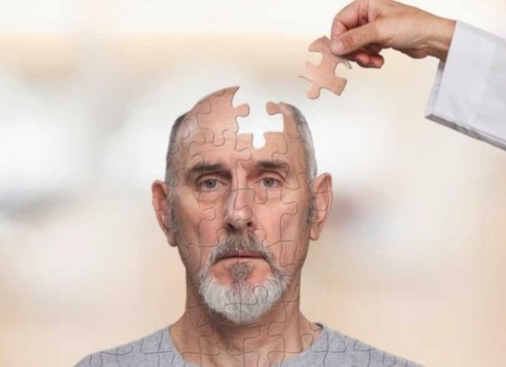
We
Humans
Everything HAS to make sense...every piece has to fit in !!
Scientifically
Religiously
Factually
Conceptually

Slide 11

We
Humans
Imaginative
Creative
Connecting dots
Making connections

Slide 12
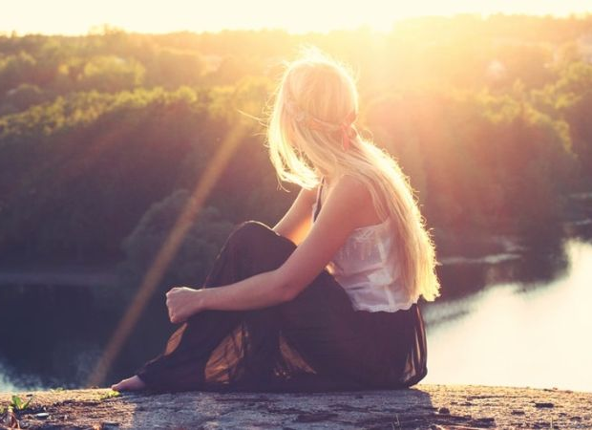
We
Humans
Innate desire to
capture the moment.
Painting
Documenting
Sculptures
Photos
Videos

Slide 13

We
Humans
Immortality.
Digital Immortality with Social Media.
Who we were.
How we lived.
What we thought.
Our "Stories".

Slide 14
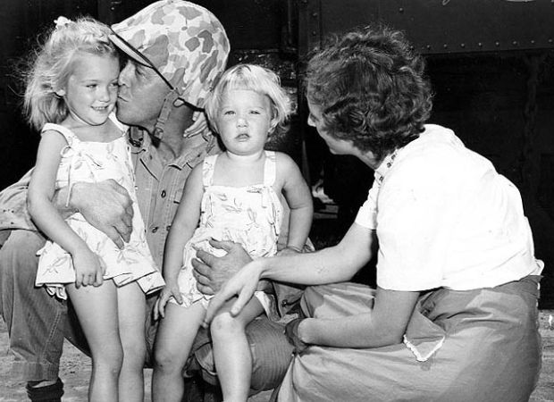
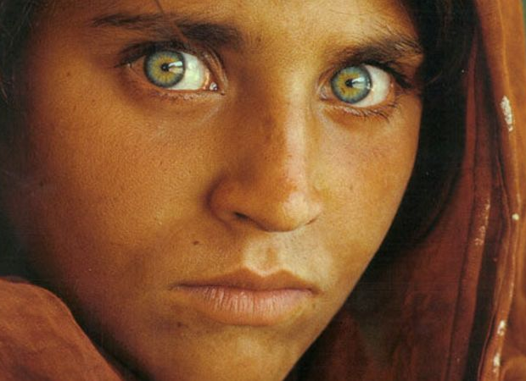
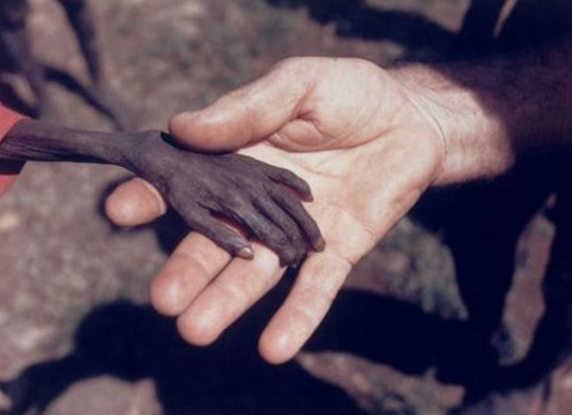
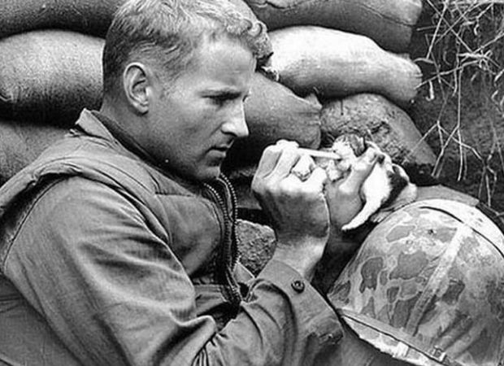
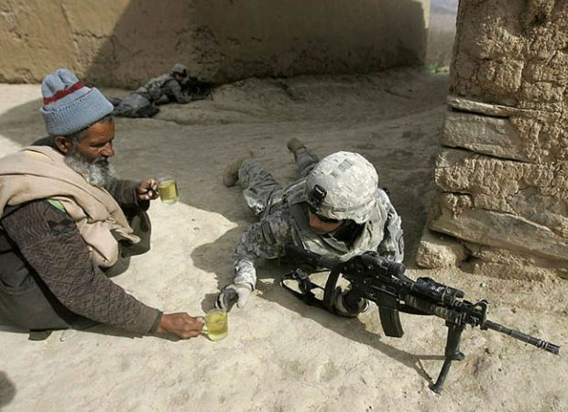
We
Humans
Compassionate
We feel others pain, joy & struggle..
..their "stories" !!

Slide 15
"We are lonesome animals. We spend all our life trying to be less lonesome. One of our ancient methods is to tell a story begging the listener to say — and to feel — “Yes, that’s the way it is, or at least that’s the way I feel it. You’re not as alone as you thought.”
John Steinbeck

Slide 16
"There have been great societies that did not use the wheel, but there have been no societies that did not tell stories.”
Ursula K. LeGuin

Slide 17
“Storytelling is the most powerful way to put ideas into the world today.”
Robert McKee

Slide 18

We
Humans
The Heider-Simmel Animation (1994)
An Experimental Study of Apparent Behavior
https://confluence.gallatin.nyu.edu/sections/creative-non-fiction/the-storytelling-animal

Slide 19


Slide 20
Humans are hardwired for
stories.
We
Humans

Slide 21
"Aoccdrnig to a rscheearch, it deosn't mttaer in waht oredr the ltteers in a wrod are, the olny iprmoatnt tihng is taht the frist and lsat ltteers be at the rghit pclae. The rset can be a toatl mses and you can sitll raed it wouthit porbelm. Tihs is bcuseae the huamn mnid deos not raed ervey lteter by istlef, but the wrod as a wlohe."

Slide 22
Human brain has the natural ability to “fill in the gaps”.
We
Humans

Slide 23
Art of Storytelling

Slide 24
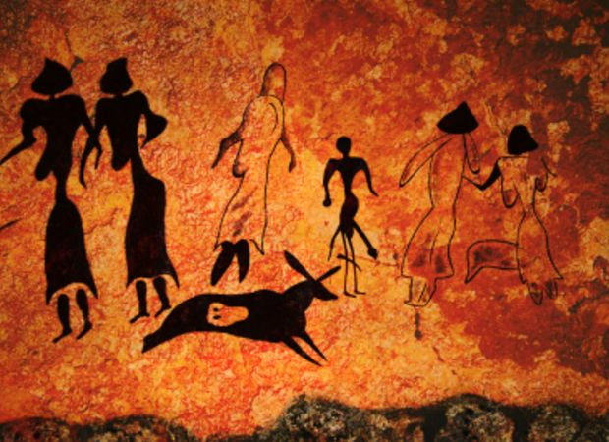
Art of
Storytelling
Cave paintings
Leave information
Share experiences

Slide 25
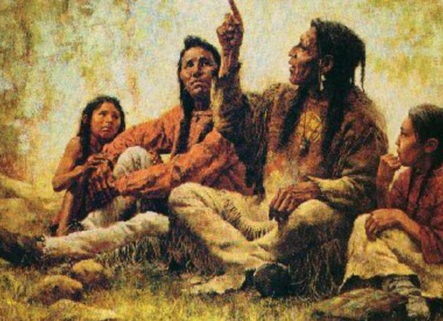
Art of
Storytelling
Word of mouth
Toddlers
An unfortunate incident
Excuses
Lessons

Slide 26
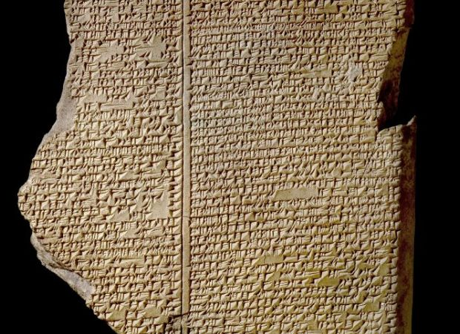
Art of
Storytelling
The first written story ever: Epic of Gilgamesh
Sumerian Uruk (modern day Iraq) in 2700 BC

Slide 27

Art of
Storytelling
Paper

Slide 28
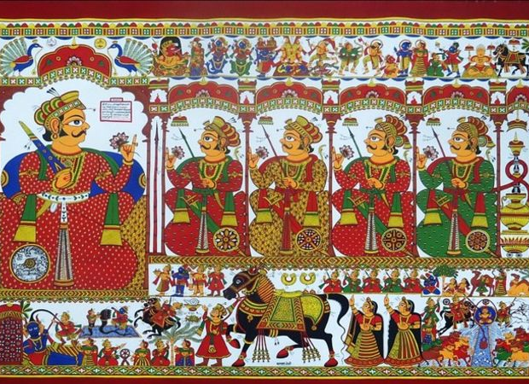
Art of
Storytelling
Scrolls

Slide 29
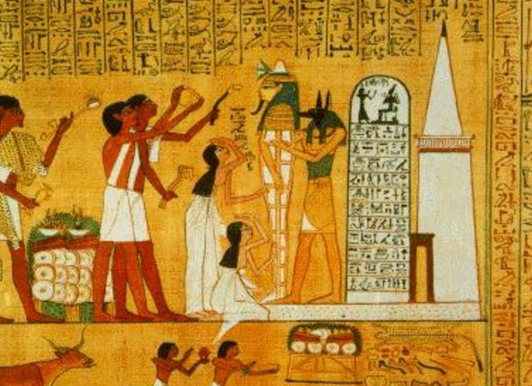
Art of
Storytelling
Calligraphy & Imagery

Slide 30
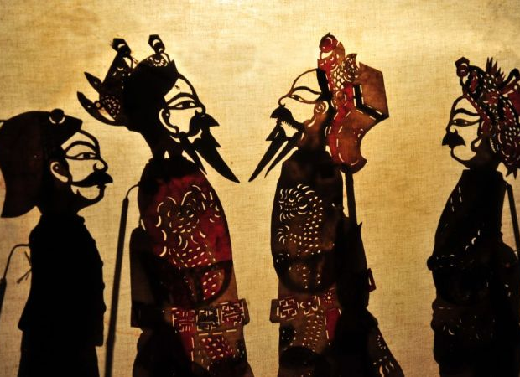
Art of
Storytelling
Puppets

Slide 31
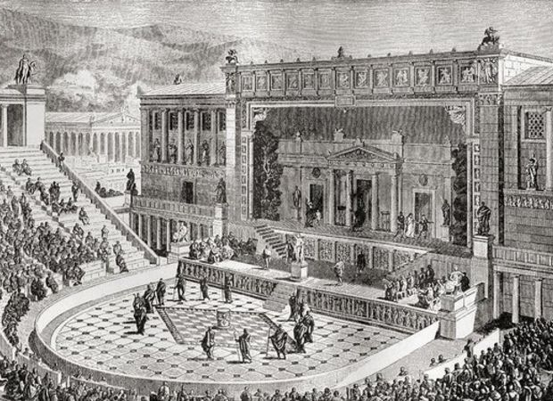
Art of
Storytelling
Theatre

Slide 32
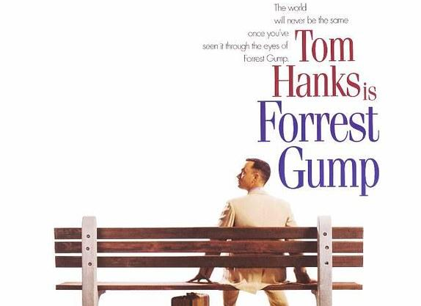
Art of
Storytelling
Movies

Slide 33
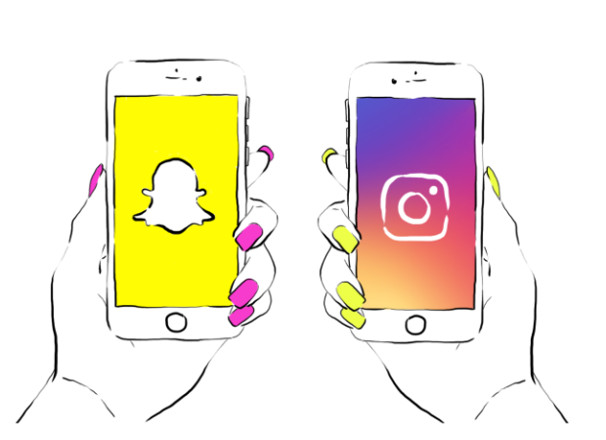
Art of
Storytelling
Social Media
https://www.clickz.com/the-rise-of-stories-and-the-changing-face-of-social-marketing/214311/

Slide 34
We are not addicted to our devices…we are addicted to stories!
We are addicted.

Slide 35
To share experience
Communicate
Find meaning
Entertain
Why do we
Tell stories?

Slide 36
Communicating Ideas & Concepts
Insights & empathy
Brand Development
Content Development
Marketing & Advertising
Social Innovation
Professional Context

Slide 37
Stories around us

Slide 38
“For a given audience, a story is a sequence of content, anchored on a problem, which engages that audience with emotion and meaning”.
Bryan Alexander
A story is the telling of an event, either true or fictional, in such a way that the listener experiences or learns something just by the fact that he heard the story. A story is a means of transferring information, experience, attitude or point of view.
What is a Story?

Slide 39
“Story” can be defined as, a series of events.
“Storytelling” can be defined as, relating a series of events.
“Story” and “narrative” mean the same thing. “Narrative” is simply a more academic term than “story”.
In a story, causality is involved in some way (along the lines: A leads to B, B leads to C, C leads to D, etc).
What is a Story?

Slide 40
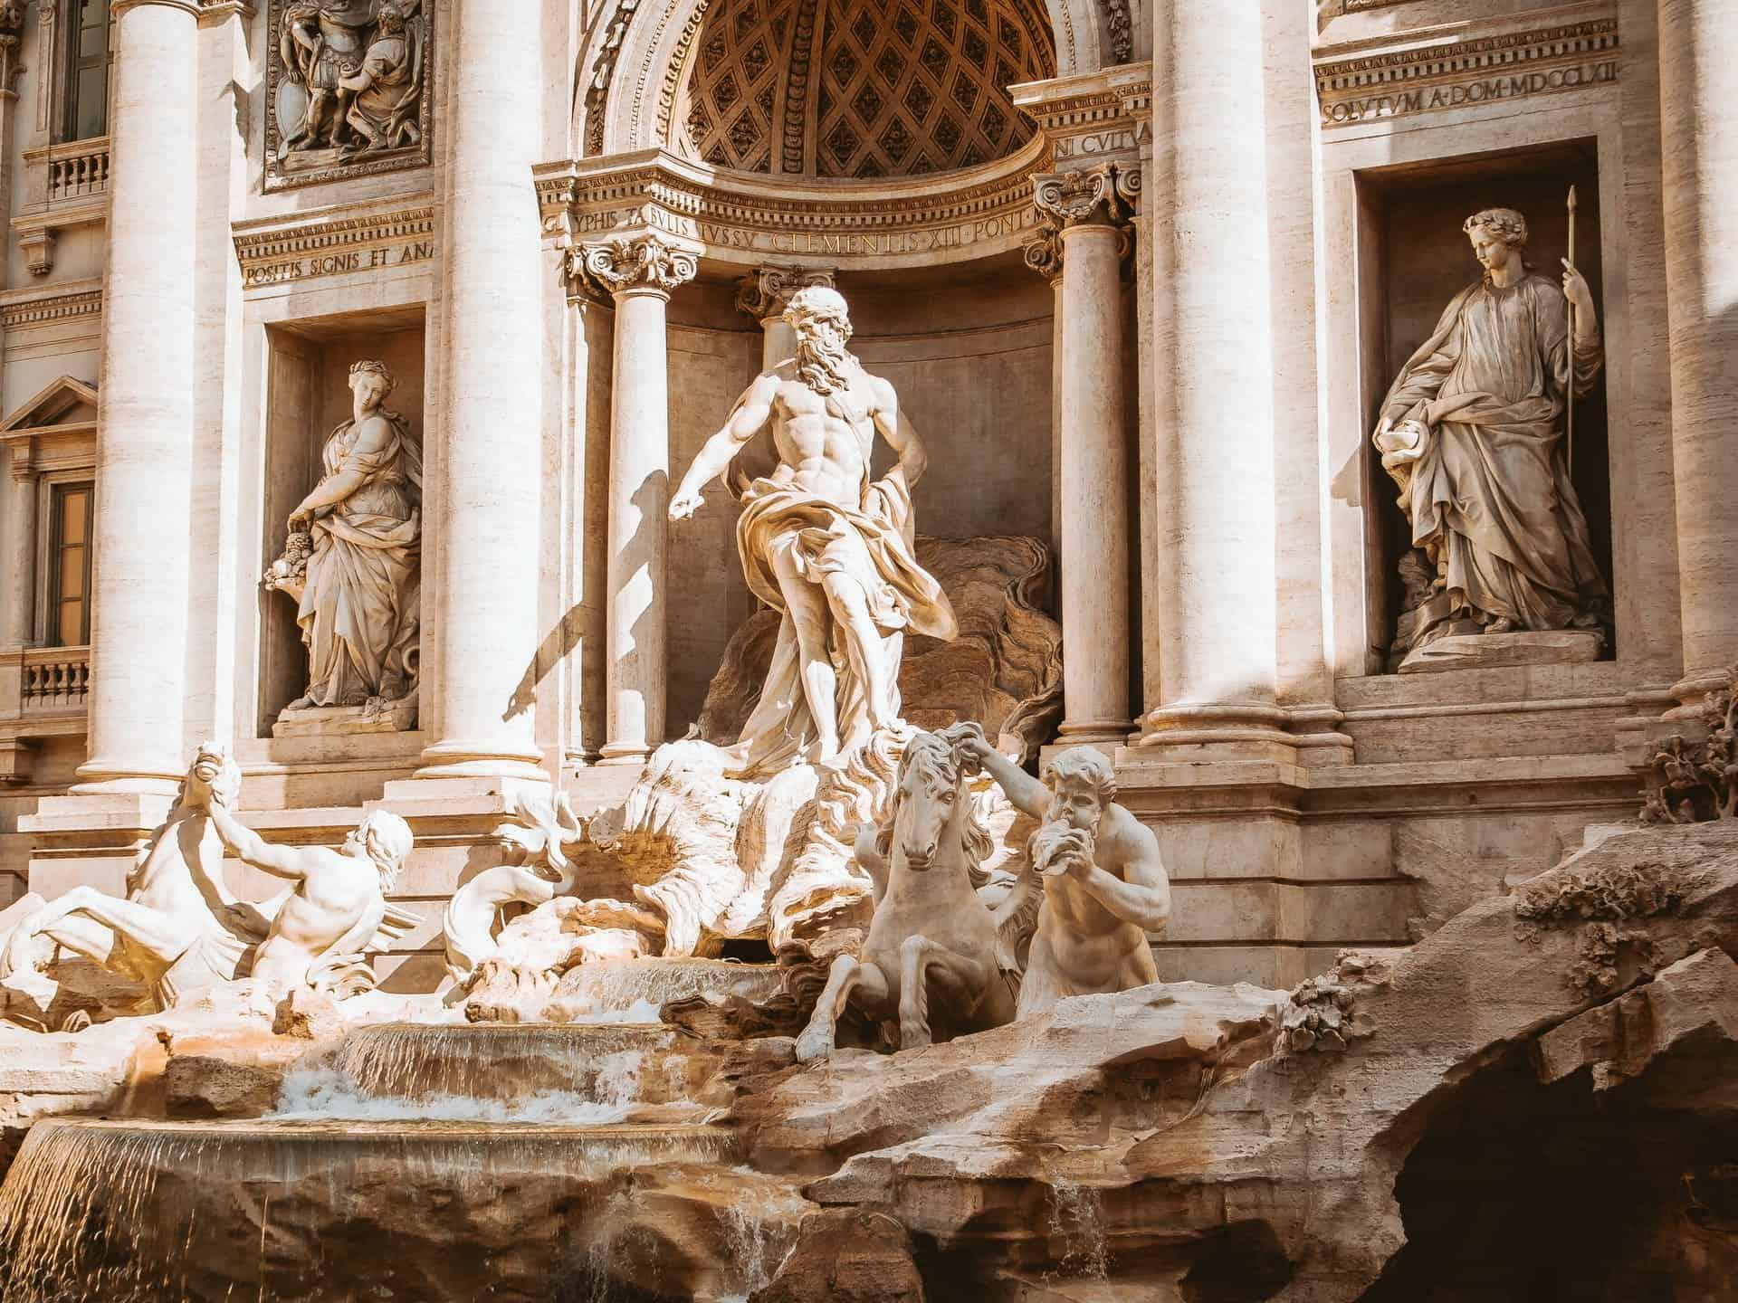
Myths
A myth is a traditional story without an author that is usually intended to teach a lesson, explain one of the many mysteries of life, explain a phenomenon of nature & describe the customs, institutions, or religious rites of a people.
.

Slide 41
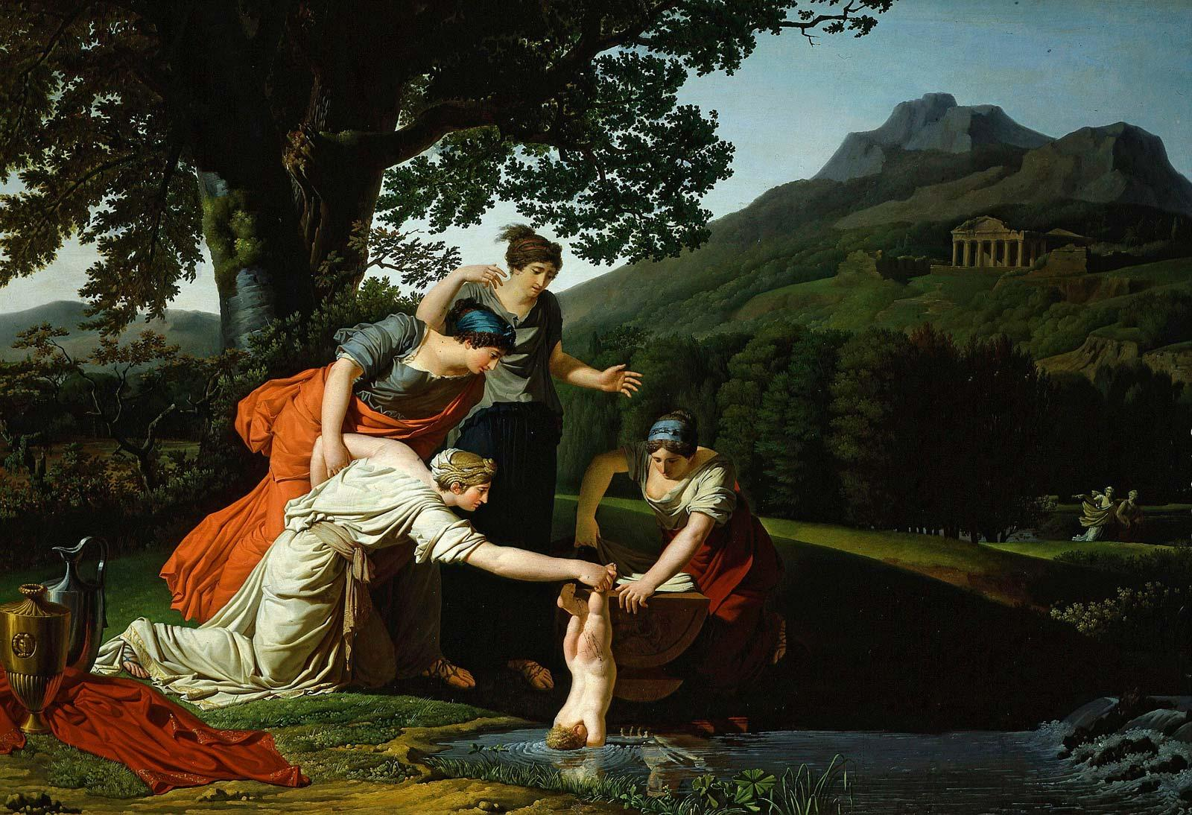
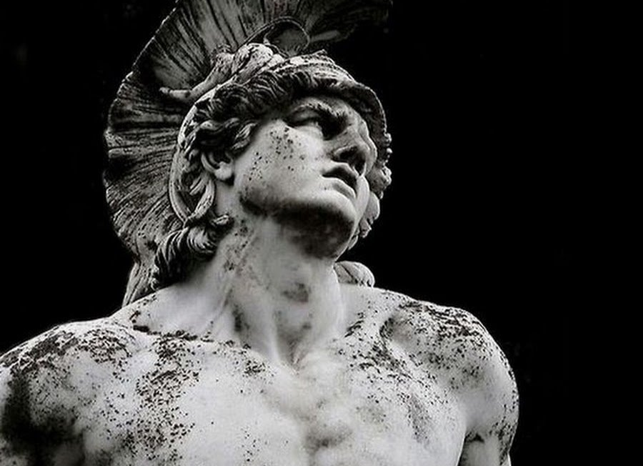
Myths
Achilles
As an infant Achilles' mother dipped him into the River Styx, which made him invulnerable everywhere but the heel by which she held him. For ten years Achilles was a great hero in the Trojan War for the Greeks. But in the end, Paris, son of the Trojan king, fatally wounded Achilles in the heel.
https://en.wikipedia.org/wiki/List_of_culture_heroes#Indian_mythology
.

Slide 42
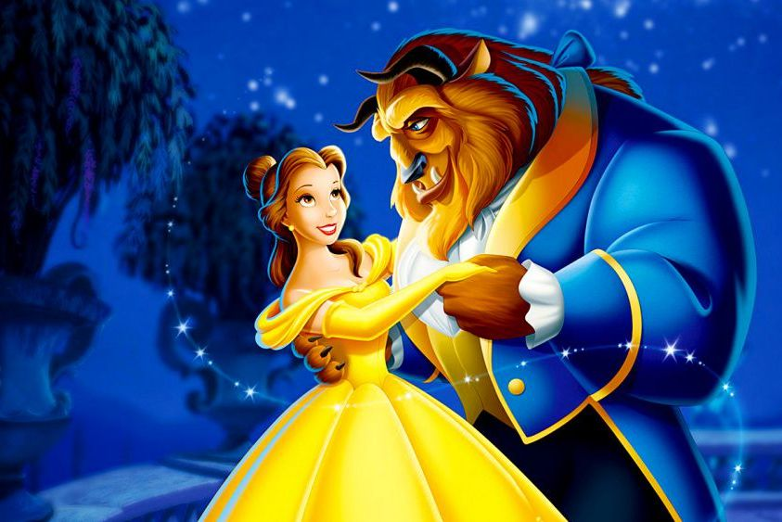
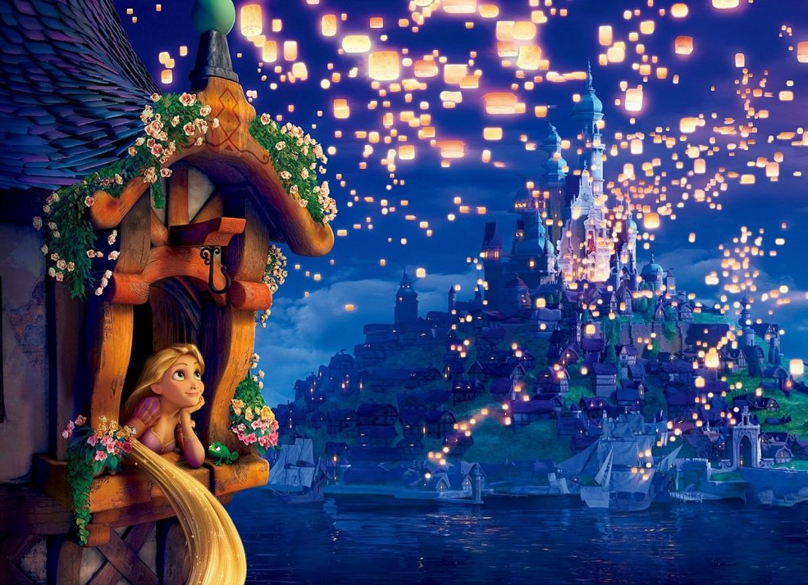
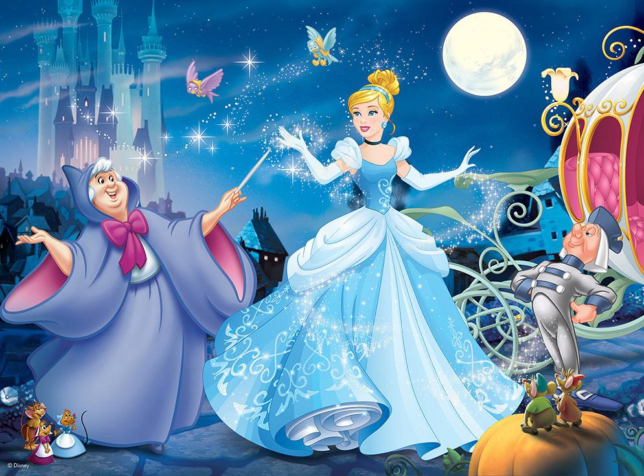
Fairy
Tales
A fairy tale is a children’s story in a magical setting about imaginary characters that include fairies, dwarfs, witches, angels, trolls, and talking animals. It is also known as a folklore genre written in the form of short stories.

Slide 43
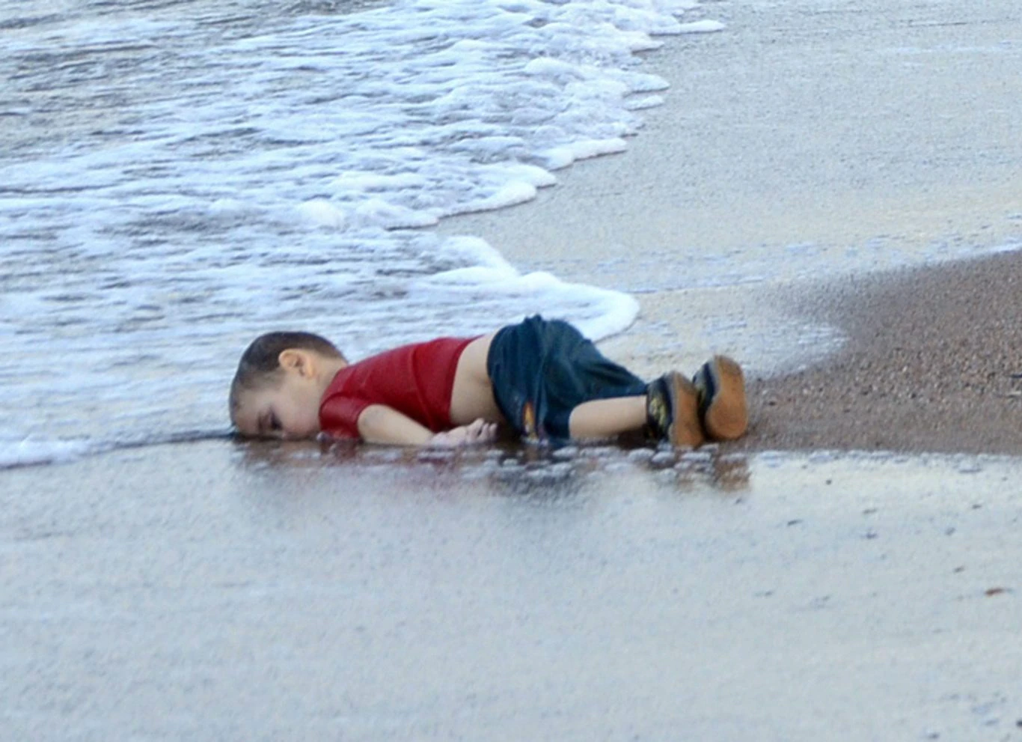
News
Stories
The war in Syria had been going on for more than four years when Alan Kurdi’s parents lifted the 3-year-old boy and his 5-year-old brother into an inflatable boat and set off from the Turkish coast for the Greek island of Kos, just three miles away. Within minutes of pushing off, a wave capsized the vessel, and the mother and both sons drowned. On the shore near the coastal town of Bodrum a few hours later, Nilufer Demir of the Dogan News Agency, came upon Alan, his face turned to one side and bottom elevated as if he were just asleep.

Slide 44
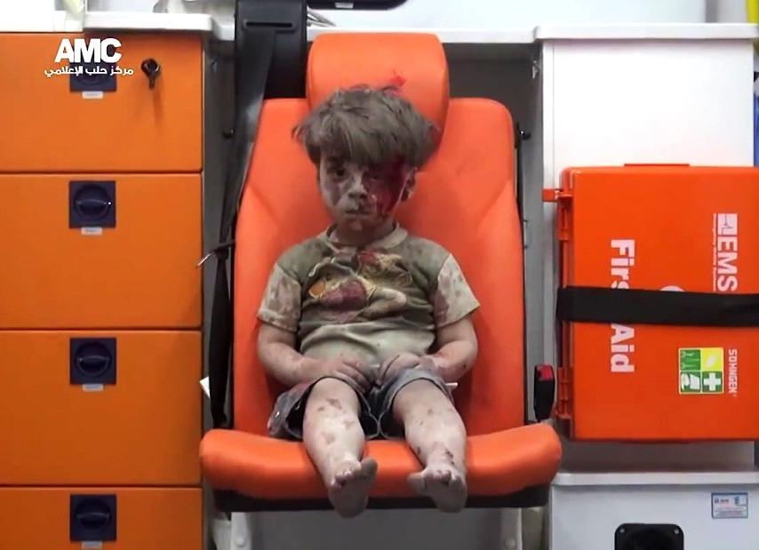
News
Stories
Omran Daqneesh was injured on August 17, 2016, in an alleged Russian Air Force strike on the rebel-held al-Qaterji neighbourhood of Aleppo, Syria. He suffered a wound to his head and was taken to a hospital known as M10 and later discharged.

Slide 45
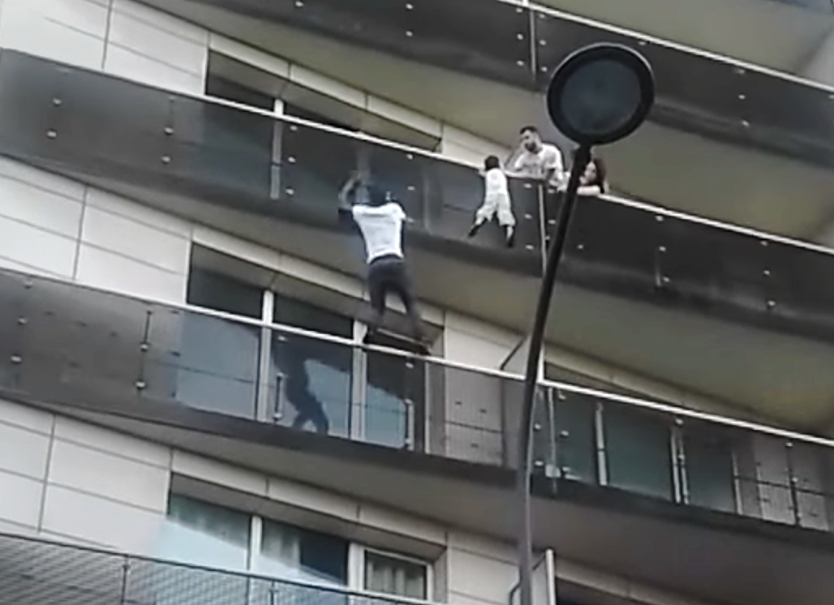
News
Stories
A young Malian man, Mamoudou Gassama, was hailed a hero on after he sprang into action to save a four-year-old child hanging from a fourth-floor balcony by single-handedly scaling the facade of the building and hauling the youngster to safety.
https://www.msn.com/en-au/news/photos/biggest-news-stories-of-2019/ss-AADx2fu#image=1
https://edition.cnn.com/2019/12/22/us/top-100-digital-stories-2019-trnd/index.html

Slide 46
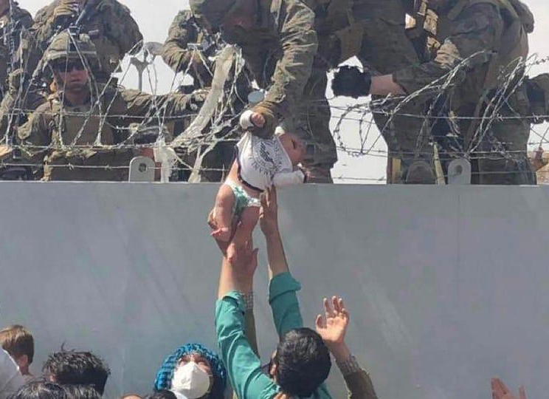
News
Stories
This image from August 20, 2021 shows a U.S. Marine grabbing an infant over a fence during an evacuation at Hamid Karzai International Airport in Kabul.
https://www.msn.com/en-au/news/photos/biggest-news-stories-of-2019/ss-AADx2fu#image=1
https://edition.cnn.com/2019/12/22/us/top-100-digital-stories-2019-trnd/index.html

Slide 47
What if you slept? And what if, in your sleep, you dreamed? And what if, in your dream, you went to heaven and there plucked a strange and beautiful flower? And what if, when you awoke, you had the flower in your hand? Ah, what then?
Samuel Taylor Coleridge
English poet, philosopher, and co-founder of the Romantic Movement in England
Flash
Fiction

Slide 48
“The last man on Earth sat alone in a room. There was a knock on the door.”
Frederic Brown, “Knock”, 1948
Flash
Fiction

Slide 49
“For sale: baby shoes, never worn.”
Unknown
(sometimes attributed to Hemingway)
Six words
story

Slide 50
Our brain connects dots (facts/incidents) and “creates” more than what actually is...it creates “stories” !
Storytelling

Slide 51
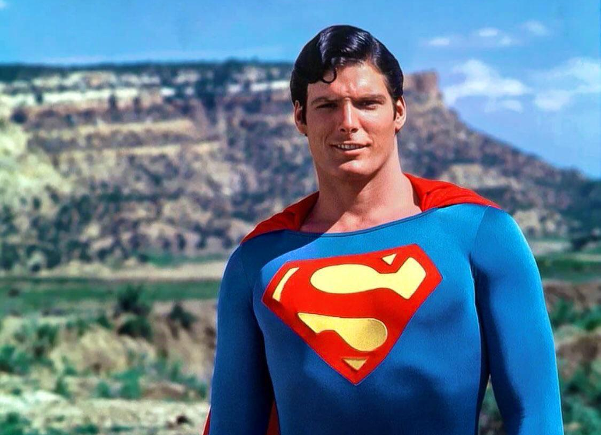
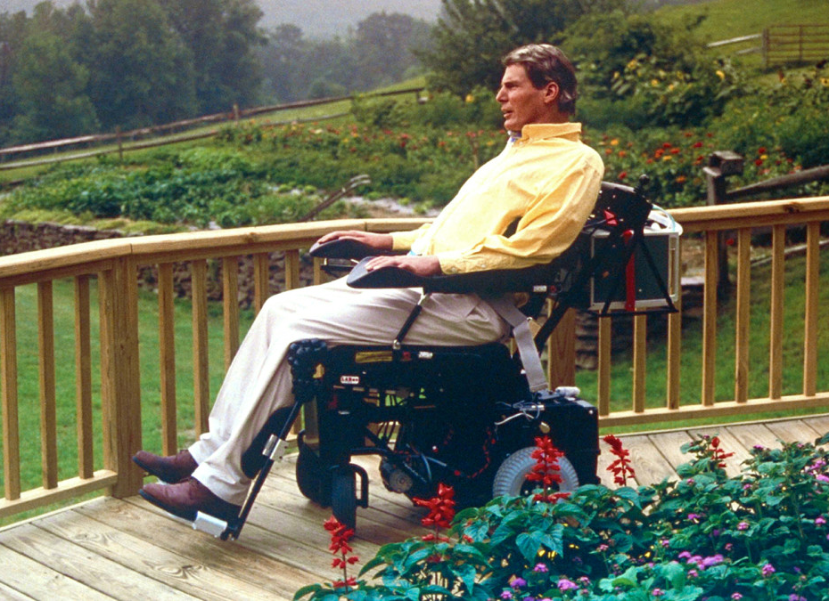
Storytelling
Christopher Reeve, the most popular & beloved Superman…
..had a horse riding accident..
..lived & died on life support.
https://www.biography.com/news/christopher-reeve-horseback-riding-accident

Slide 52
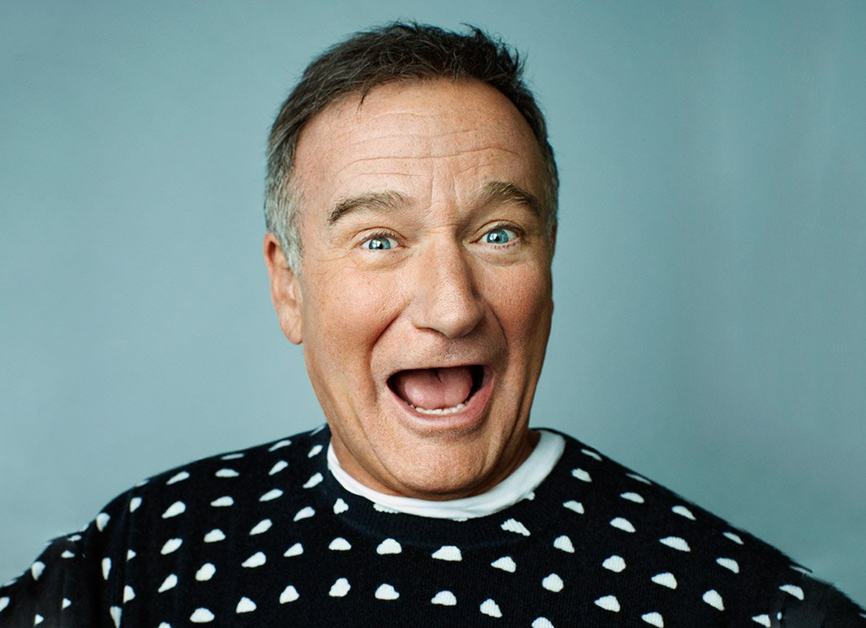
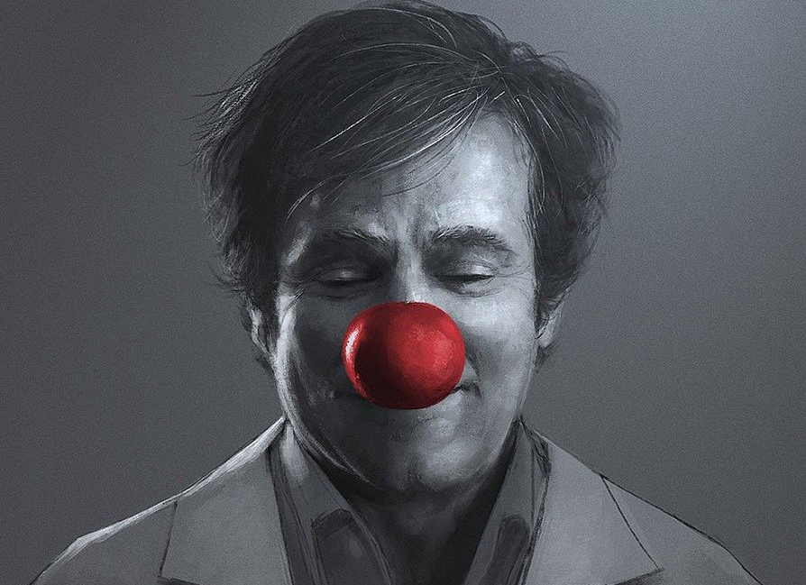
Storytelling
Robin Williams..
..the iconic comic actor..
..commits suicide.

Slide 53
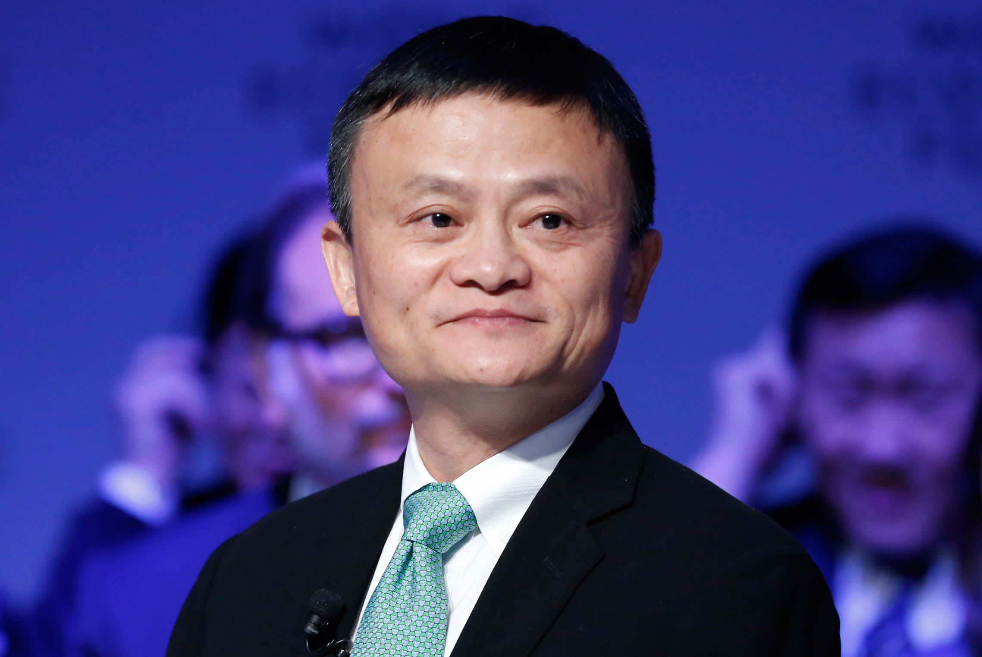
Storytelling
Jack Ma failed to land a job after applying to them 30 times!
He recollects in his interview, “When KFC came to China, 24 people went for the job. Twenty-three people were accepted. I was the only guy who wasn’t.”
He is now officially the richest man in China with an estimated net worth of $25 Billion, on the back of the recent world record $150 Billion IPO filing of his company.

Slide 54
A Movie I remember for it’s Story, & why?
A Historic event Story I remember, & why?
A recent Social Media Story I remember, & why?
Your
Turn.

Slide 55
With an example, reflect on the Stories amongst us, & how they affect (guide, inform, inspire, teach, warn, move, entice, mislead) us?
Your
Turn.

Slide 56
Patterns in Stories

Slide 57
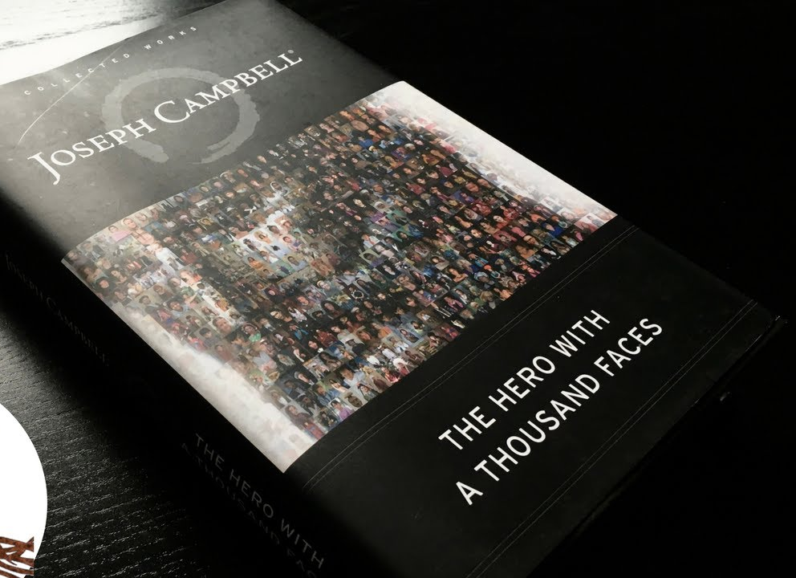
Joseph
Campbell
The Hero with a Thousand Faces
‘Monomyth’ - a theory that suggests that all mythical narratives exist as variants of a theme.

Slide 58
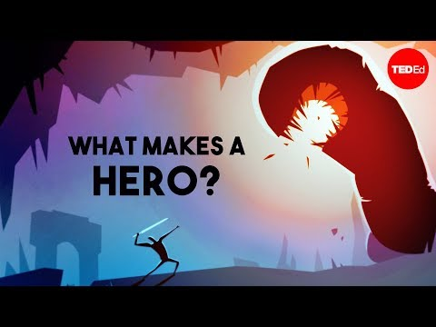

Slide 59
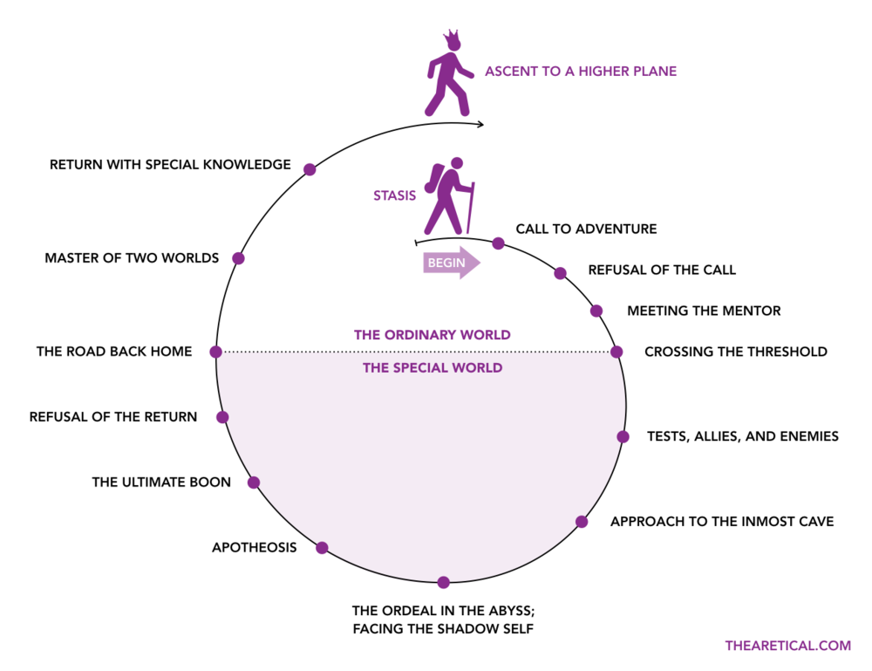
A Hero’s Journey
Notes:
Comfort zone, voluntary action or forced, journey to growth, in the different world & place,
Students in the university, life from heaven, to earth, and back to earth.

Slide 60
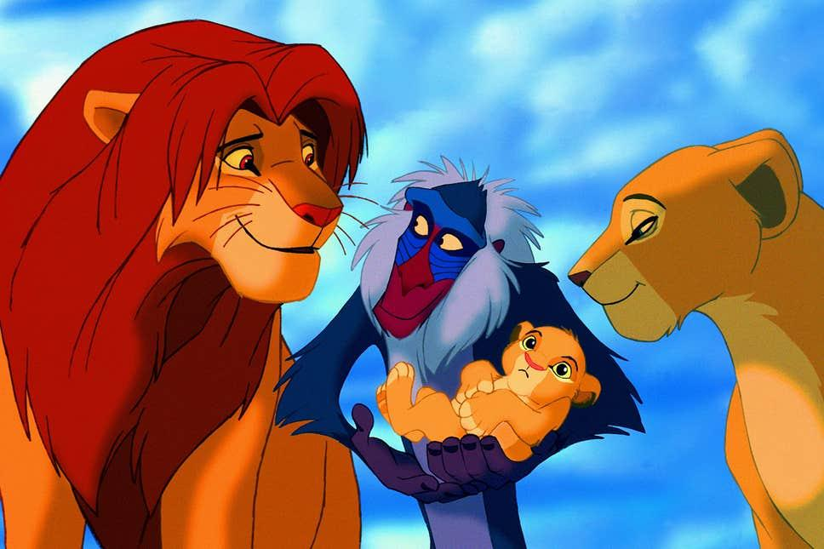
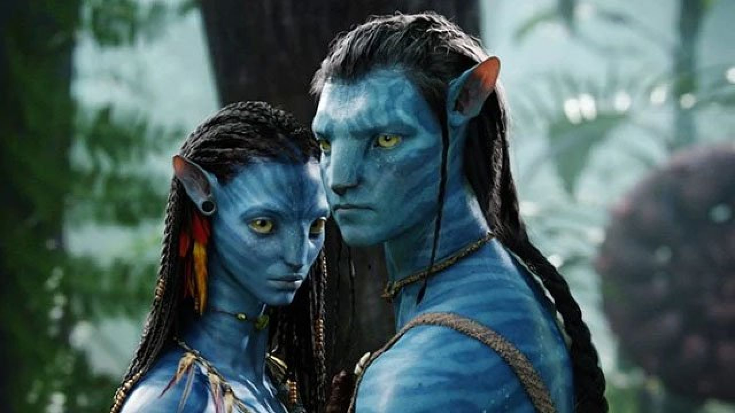
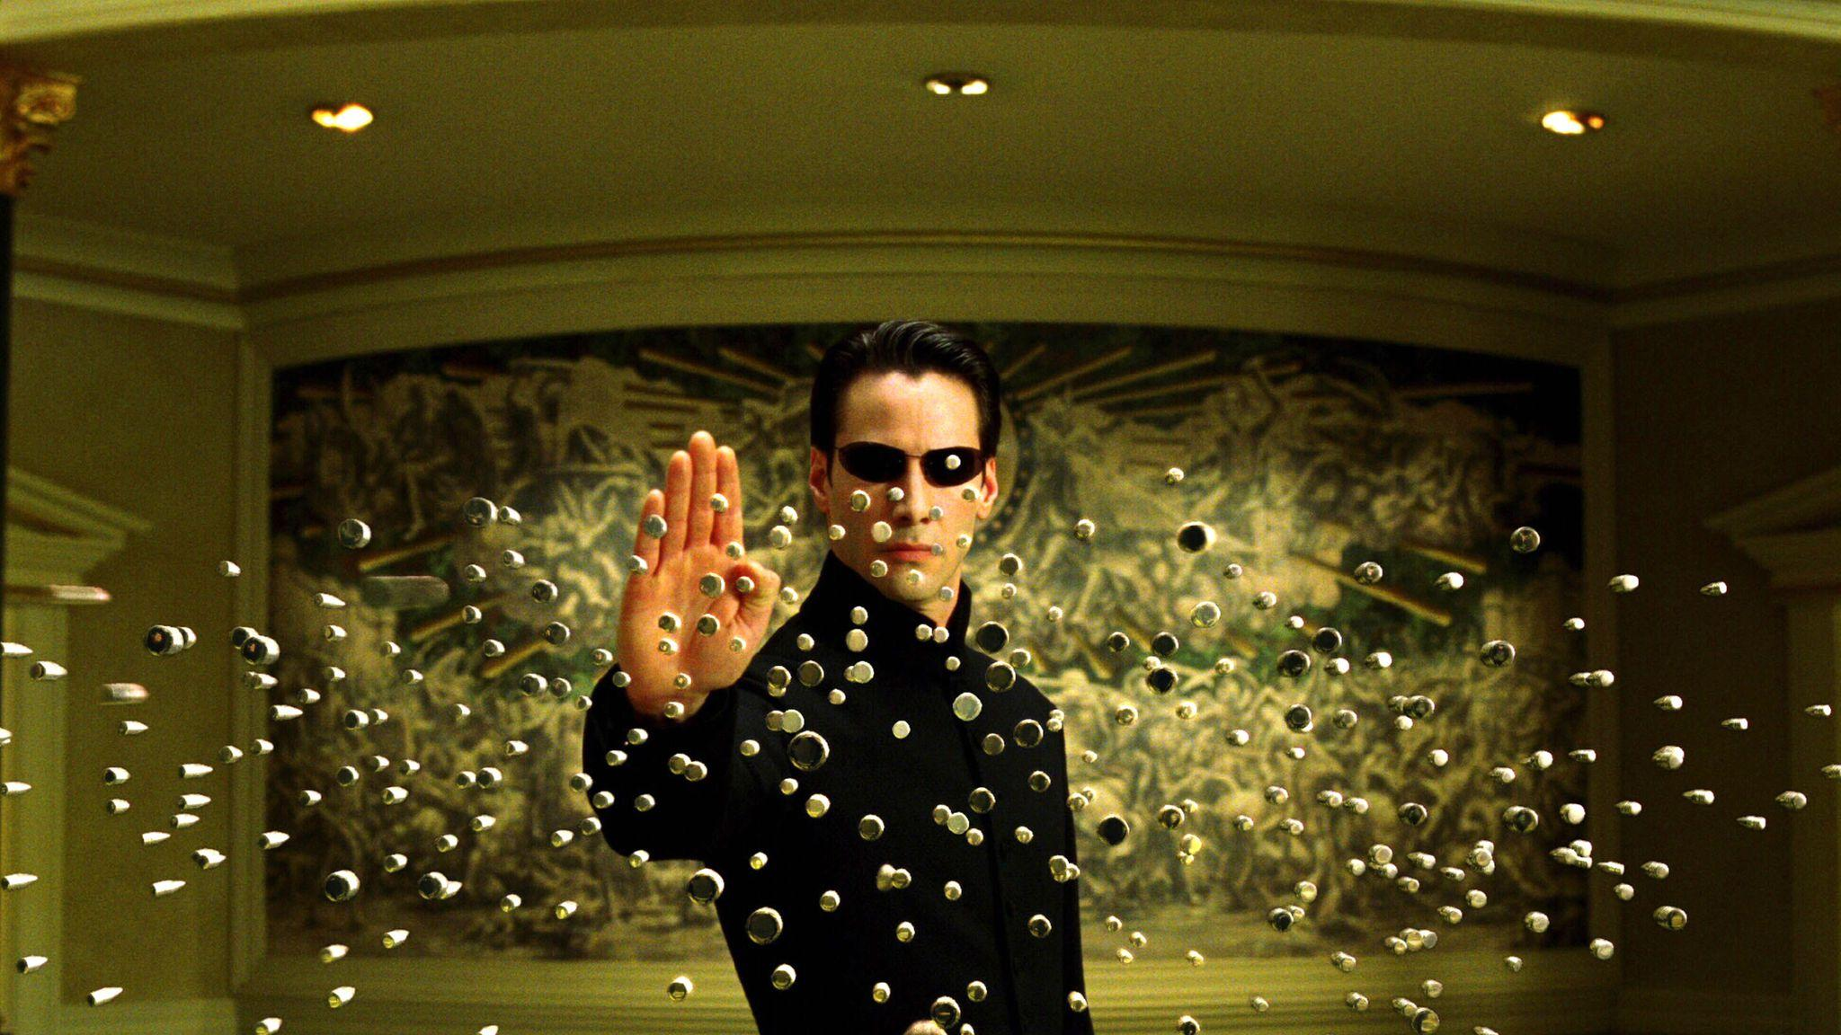
Patterns in Stories.

Slide 61
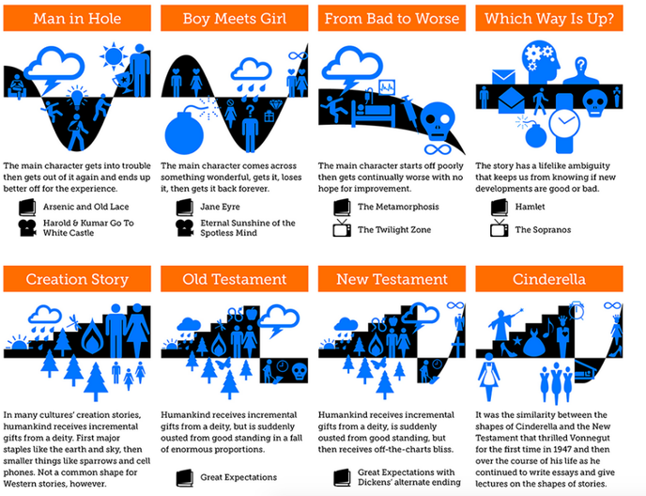
Kurt Vonnegut
Shape of All Stories
https://bigthink.com/culture-religion/vonnegut-shapes?rebelltitem=3#rebelltitem3

Slide 62
Overcoming the Monster
Rags to riches
The Quest
Voyage & return
Comedy
Tragedy
Rebirth
Patterns in Stories.

Slide 63
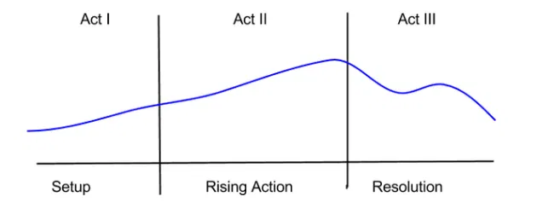
The 3 Act structure.
Patterns in Stories.

Slide 64
The “ONE DAY” factor!
(before & after THAT ONE DAY!)
Patterns in Stories.

Slide 65
Commercial Storytelling

Slide 66
For most of their existence, TV commercials have been like, “Hey, buy this product! It’s faster, cheaper, more efficient!”
Then, around 2012, we saw an increase in commercials that tell stories.
They don’t always talk about the “selling point,” which was always a big deal in advertising: Why do you have to buy this product?
Instead of simply telling you about the benefits of the product, they show how the advertised product can help you achieve your consumption goals. It doesn’t really say anything directly about the product, but still it’s very persuasive.
Commercial
Storytelling

Slide 67
Commercial Storytelling is using a narrative to connect your brand & product to your customers.
People remember stories.
If you put a story capable of evoking emotions in your viewers, they will never forget the experience.
Brands do not sell their products anymore...they sell stories.
Commercial
Storytelling

Slide 68
“Micro-moments” are those small, often overlooked routines and rituals that make up our daily lives:
tying our shoelaces, sitting down for coffee, commuting to work, brushing our teeth, enjoying a meal, etc.
Facebook calls them “once-a-day moments,” and for advertisers, they can serve as an especially powerful tool for connecting with audiences; in fact, brands that incorporate these moments can sometimes be easier for us to recall and remember.
Highlight micro
Moments.
https://www.linkedin.com/pulse/72-rules-commercial-storytelling-jeremy-waite

Slide 69
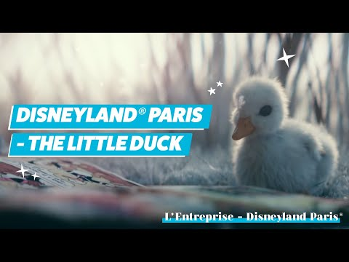

Slide 70
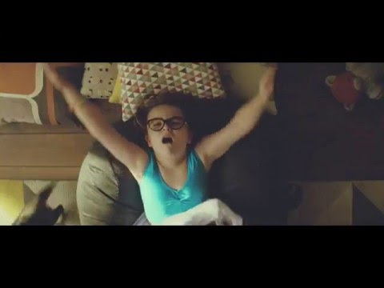

Slide 71
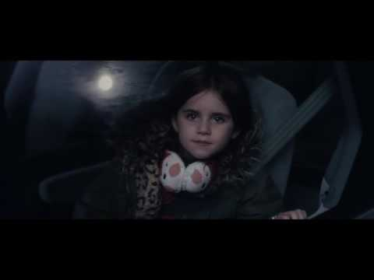

Slide 72
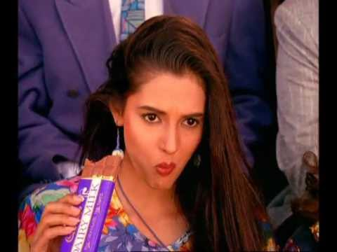

Slide 73
A computer on every desk..
..and in every home.
Bill Gates

Slide 74
Twice as fast.
Half the price.
Steve Jobs on the iPhone 3G

Slide 75
One study found that a painting became 11% more valuable when the artist’s story was featured below it.
Small businesses with ethically-made, locally-sourced products can actually increase the perceived value of the products by featuring the story of the workers engaged in the production.
Commercial
Storytelling

Slide 76
Digital Storytelling

Slide 77
Storytelling: Telling or writing of stories. An ancient art form and a valuable form of human expression.
Digital: Computer-based tools, content & delivery.

Slide 78
“Digital Storytelling is the modern expression of the ancient art of storytelling”. (Barrett, 2007)
“Digital storytelling combines the art of telling stories with a variety of digital multimedia, such as images, audio, and video. Just about all digital stories bring together some mixture of digital graphics, text, recorded audio narration, video and music to present information on a specific topic.” (Robin, 2008)
Digital
Storytelling

Slide 79
“Digital storytelling involves the use of graphics, images, pictures, sound, and videos to engage the viewers in an effort to drive emotions, engage intercommunication, and motivate an audience to action.”
Eric and Sacha

Slide 80


Slide 81
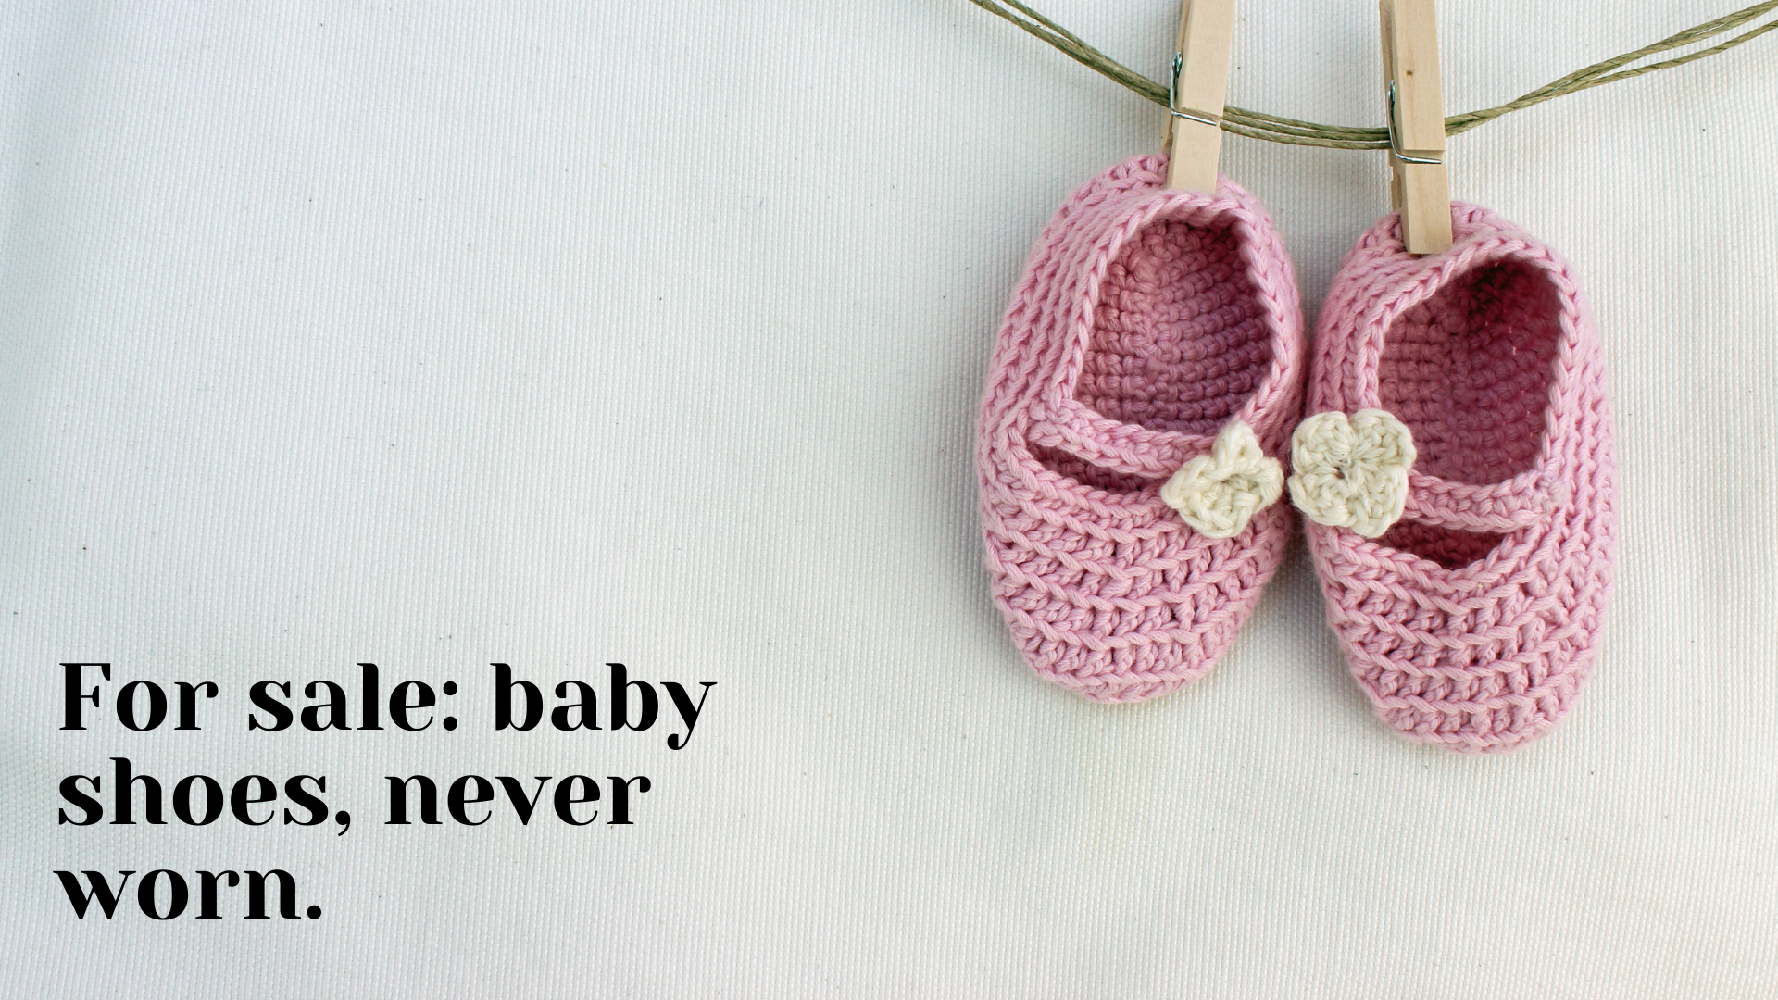

Slide 82


Slide 83
The Boat
The Bear and the Scarf
Heschung
Saving Maggie
Every Last Drop
The Fallen
Few Great Examples

Slide 84
https://www.angrytide.io/
https://gleec.com/pay
https://beta.hearingbirdsong.com/
Few Great Examples

Slide 85
Structure
Linear | Side-Branches | Non-Linear
Assets
Photos | Videos | Audio | Text | Graphics
Design
Composition | Layout
Technology
Web | App | Game | Slideshow | Videos
Accessibility
How & where does the audience consume it?
5 Elements
Of Digital
Storytelling

Slide 86
“You can tell any story 20 different ways. The trick is to pick one and go with it.”
Clint Eastwood
American actor, director, producer, and politician

Slide 87
Intellectual Property (IP)

Slide 88
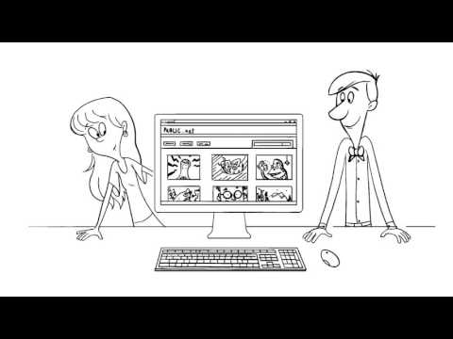

Slide 89
Intellectual property (IP) refers to creations of the mind: inventions, literary and artistic works, and symbols, names, images, and designs used in commerce.
World Intellectual Property Organization
http://www.wipo.int/about-ip/en/
https://dh.sites.gettysburg.edu/toolkit/media/copyright/
Intellectual Property

Slide 90
Another person is benefitting from someone else’s creativity and effort without paying or crediting the original creator.
Why would anyone want to create things if they weren’t going to benefit financially and someone else was?
Are there any reasons why you would argue for personal copying or posting content without authorization?
Ethical Concerns

Slide 91
People believe that if they change a work enough or use it in a collage, it is not infringement.
Many people do not understand the extent of ownership.
If people understood intellectual property rules at the start, they could find works that are in public domain and available in fair use.
Intellectual Property

Slide 92
Few important terms:
Attribution: Identifying & crediting the source of a work.
Copyright: A form of legal protection given to the creators of "original works of authorship“.
Copyright infringement: A violation of the exclusive rights of a copyright holder, such as copying, distributing, or performing the copyright owner's work without permission.
Derivative work: A new work that translates or transforms one or more original copyrighted works.
Fair use: Permits a second user to copy part or all of a copyrighted work without permission from the copyright holder.
License: Permission to use a creative work.
Intellectual Property

Slide 93

An intellectual work is any original work in the areas of literature, arts or science, whatever its description, form of expression, significance or purpose.
Author’s Rights:
Reproduce the work in copies
Distribute copies of the work
Publicly display or perform
Make derivatives, adaptations, translations
Authorize others to use any of these rights
Copyright protection is automatic once a work is fixed in a tangible medium. Joint authors each have full and equal copyrights.
Copyright

Slide 94
The meaning of the circled “C” is absolute:
The work belongs completely to the owner, and no one else may use it, except for research, education, or fair comment. These exceptions mean that most educators and program leaders may use copyrighted materials for teaching, but not for works that will be sold.
Copyright

Slide 95
Purpose: Criticism, comment, news reporting, teaching, scholarship, or research and parody.
Factors:
Purpose and character of the use, including whether it is commercial nature or for nonprofit educational purpose.
The nature of the copyrighted work (creative, fact, useful, compilation).
The amount and substantiality of the portion used in relation to the whole (a short quote or an entire article).
The effect of the use upon the potential market for or value of the copyrighted work.
Fair Use

Slide 96

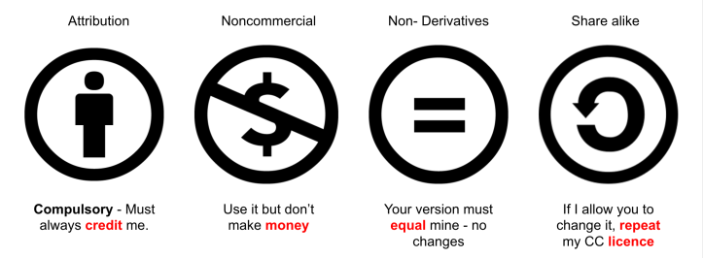

Creative Commons (CC) is a non-profit organization devoted to expanding the range of creative works available for others to build upon legally and to share.
Creative Commons (CC) is less rigid than traditional copyright, in which all rights are reserved, using the expression “some rights reserved.”
Creative
Commons
https://creativecommons.org/

Slide 97
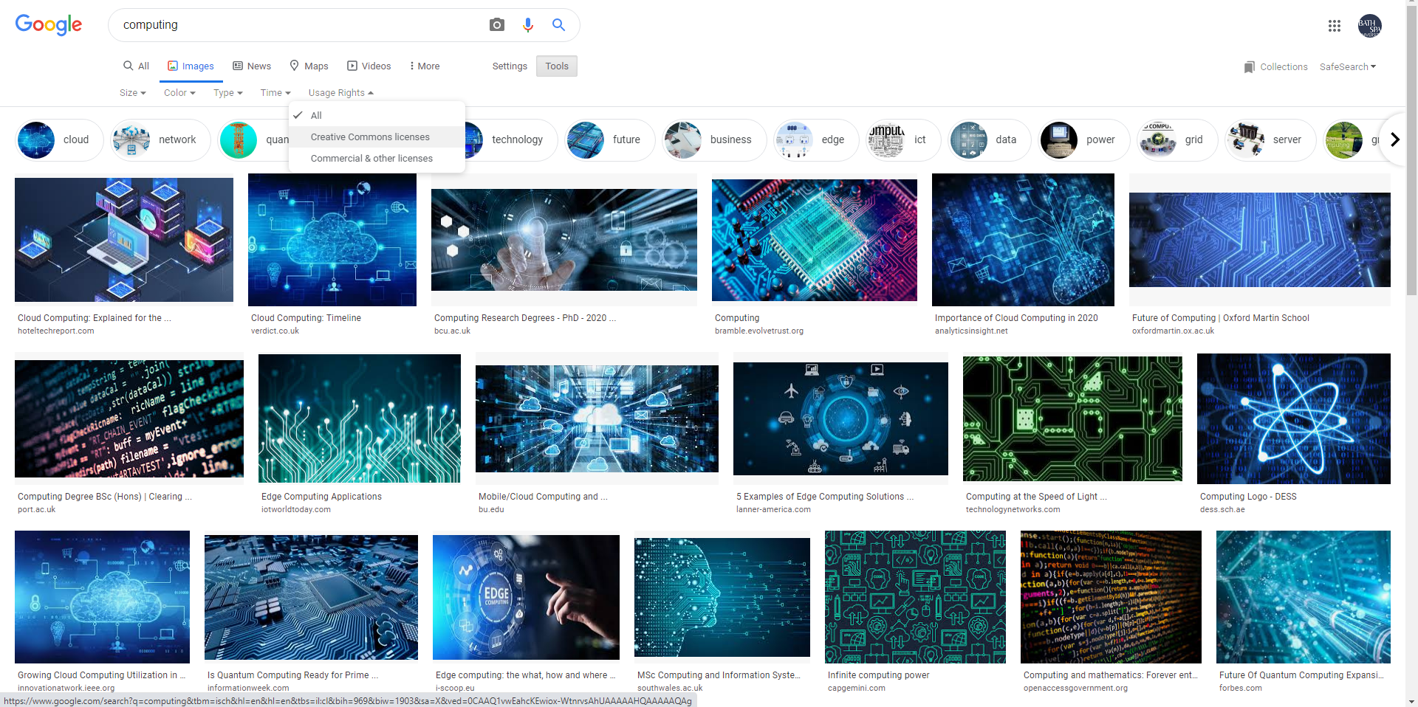

Slide 98

Public Domain are works that for one reason or another are not covered by copyright and are ordinarily free for all to use.
Type of work not protected under copyright or patent/trademark.
Work dedicated to public domain by owner.
No permission is required for works in Public Domain.
If it’s in public domain, you may use it, but creative honesty requires that you still attribute to the source and author.
Public
Domain

Slide 99




A trademark is any distinguished form of names, words, signatures, letters, figures, graphics, logos, titles, hallmarks, seals, pictures, patterns, announcements, packs or any other marks or group of marks, if they were used or intended to be used either to distinguish goods, products or services.
Trademarks

Slide 100
Read Google’s legal document here:
What is Copyright?
What is Fair Use?
Frequently asked Copyright questions.
More readings:
https://www.copyrightlaws.com/copyright-tips-legally-using-google-images/
More on Intellectual Property

Slide 101
Digital Story Experience

Slide 102
Select a short story.
https://americanliterature.com/short-short-stories
http://www.english-for-students.com/Very-Short-Stories-for-Kids.html
https://parenting.firstcry.com/articles/top-20-short-moral-stories-for-children/
Explore tools to put images, music & text together.
https://influencermarketinghub.com/free-video-editing-software/
http://www.orangefreesounds.com/walking-through-city-park-ambience/
http://www.fromtexttospeech.com/
Prepare an ambitious digital story experience.
You must provide reference to the original story published online, at the end of the artifact.
You are free to source & use any kind of assets.
You are encouraged to explore & execute everything you can (voice over, animation, etc) to prepare & deliver your best work to a Digital Story Experience.
To be Submitted:
A video file of max 2 mints.
Upload on your private Youtube account, & submit the link on given Google Form.
Your
Turn.
Samples:
Google Slides
Adobe Spark

Slide 103
Key advice.
You should identify & select a (very) short story published online.
You are not required to & may not write the story yourself.
You artifact’s length should be between 10-15 frames/slides & max 2 mints.
An appropriate background music is a MUST.
You are free to insert custom sounds (affects), narration or voice overs into individual frames/slides.
The Each frame/slide should have a background image/video with limited text.
The text on each slide should be appropriately formatted in font, size & place..
Set the duration of each frame/slide, for the reader can comfortably read the text.
The artifact will be Graded on:
Overall “audience experience”.
Choice of Assets & overall Composition.
Technique & tools used.
Your
Turn.
Samples:
Google Slides
Adobe Spark

Slide 104
https://www.openshot.org/
https://www.videostudiopro.com/en/free-trials/
https://lwks.com/
Design
Resources
Digital AV Story

Slide 105
Photography

Slide 106
The great pictures just stop time. They capture something that did not continue. It just was then, and that was the perfect moment. It wasn’t the moment before. It wasn’t the moment after. It was that moment.

Slide 107
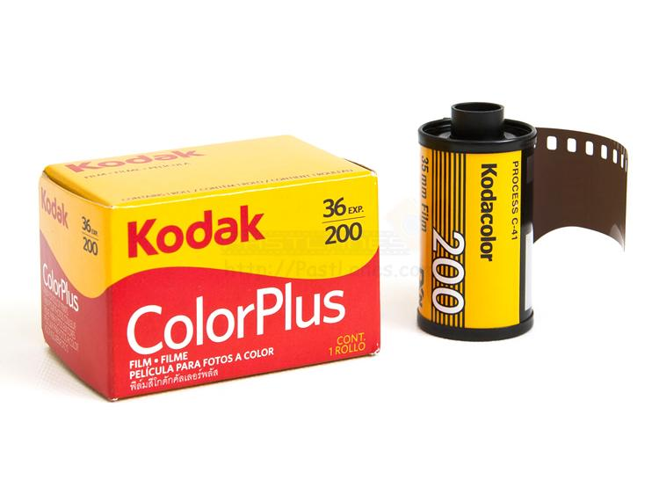
Basics of
Photography
The Exposure

Slide 108
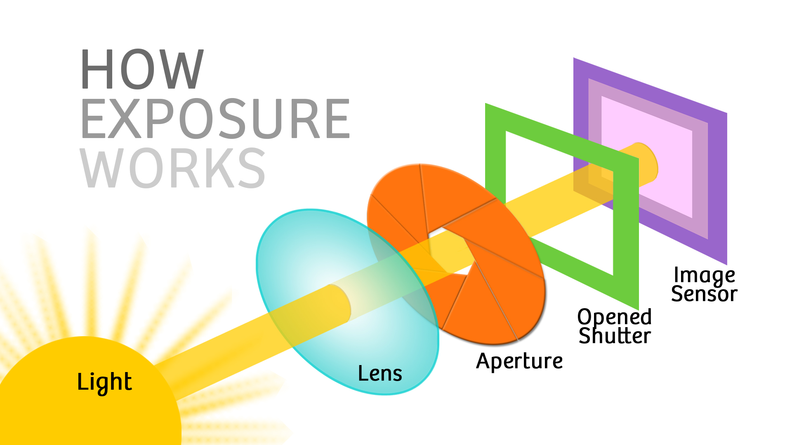
Basics of
Photography
Understanding
The Exposure

Slide 109
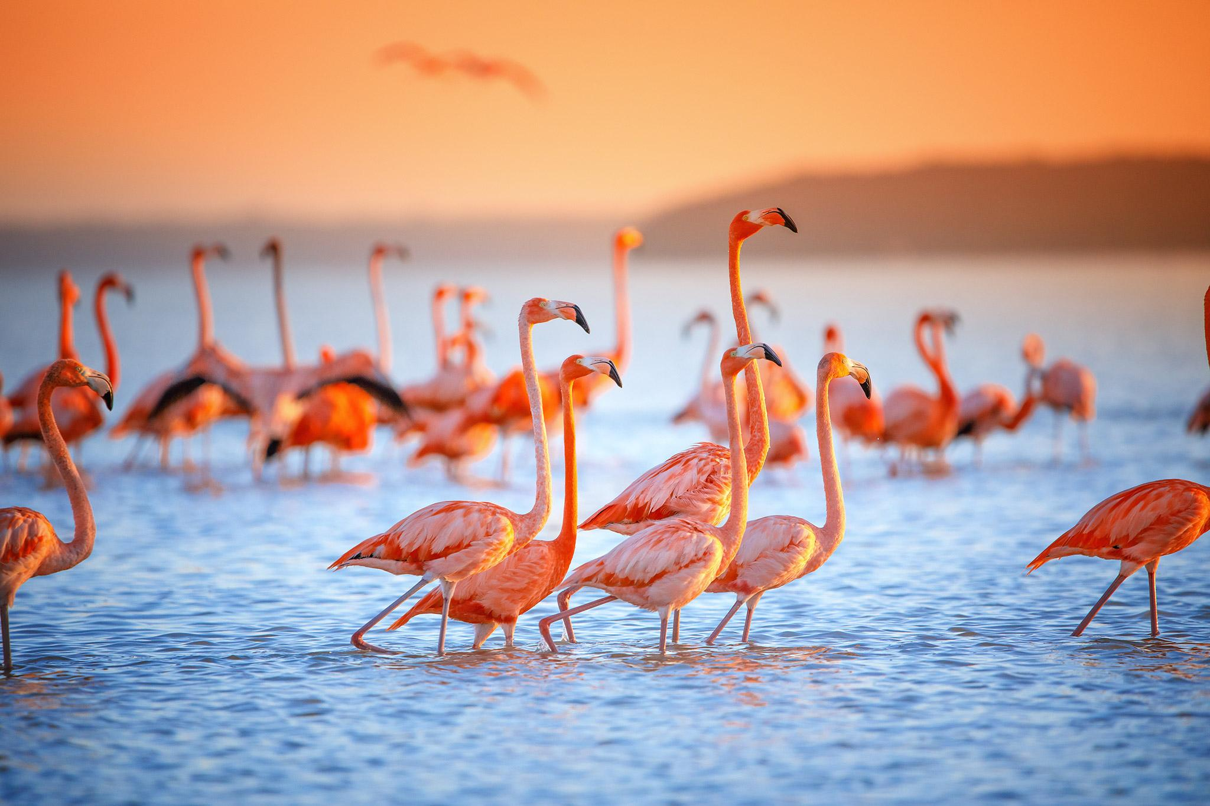
Basics of
Photography
Understanding
The Exposure

Slide 110

Basics of
Photography
Understanding
The Exposure

Slide 111

Basics of
Photography
Understanding
The Exposure

Slide 112

Basics of
Photography
Understanding
The Exposure

Slide 113

Basics of
Photography
Understanding
The Exposure

Slide 114

Basics of
Photography
Understanding
The Exposure

Slide 115

Basics of
Photography
Understanding
The Exposure

Slide 116

Basics of
Photography
Understanding
The Exposure

Slide 117
Cornerstones of a “Great Exposure”:
Sharp Focus with Crystal Clear Details
Great Composition
Alignments
Intent

Slide 118

Basics of
Photography
The Exposure
Triangle

Slide 119

Basics of
Photography
1 |
Aperture
F Stops

Slide 120

Basics of
Photography
1 |
Aperture
F Stops

Slide 121

Basics of
Photography
1 |
Aperture
F Stops
Depth of Field

Slide 122

Basics of
Photography
1 |
Aperture
F Stops
Depth of Field

Slide 123

Basics of
Photography
1 |
Aperture
F Stops
Depth of Field

Slide 124

Basics of
Photography
1 |
Aperture
F Stops
Depth of Field

Slide 125

Basics of
Photography
1 |
Aperture
F Stops
Depth of Field

Slide 126

Basics of
Photography
1 |
Aperture
F Stops
BOKEH

Slide 127

Basics of
Photography
1 |
Aperture
F Stops
BOKEH

Slide 128
Basics of
Photography
The Exposure
Triangle

Slide 129

Basics of
Photography
2 |
Shutter Speed

Slide 130

Basics of
Photography
2 |
Shutter Speed

Slide 131
Basics of
Photography
2 |
Shutter Speed
High

Slide 132

Basics of
Photography
2 |
Shutter Speed
High

Slide 133

Basics of
Photography
2 |
Shutter Speed
Slow

Slide 134

Basics of
Photography
2 |
Shutter Speed
Slow

Slide 135

Basics of
Photography
2 |
Shutter Speed
Slow

Slide 136
Basics of
Photography
The Exposure
Triangle

Slide 137

Basics of
Photography
3 |
ISO

Slide 138

Basics of
Photography
ISO

Slide 139

Basics of
Photography
3 |
ISO
Low

Slide 140

Basics of
Photography
3 |
ISO
High

Slide 141
Play | by Canon

Slide 142
Photography Rules

Slide 143

Photography
Rules
Rule of Thirds

Slide 144

Photography
Rules
Rule of Thirds

Slide 145

Photography
Rules
Rule of Thirds

Slide 146

Photography
Rules
Rule of Thirds

Slide 147

Photography
Rules
Rule of Thirds

Slide 148

Photography
Rules
Rule of Thirds

Slide 149

Photography
Rules
Leading Lines

Slide 150

Photography
Rules
Leading Lines

Slide 151

Photography
Rules
Leading Lines

Slide 152

Photography
Rules
Experiment with Cropping

Slide 153

Photography
Rules
Experiment with Cropping

Slide 154

Photography
Rules
Experiment with Cropping

Slide 155
Rule of Thirds
Fill the Frame
Leave breathing space all around
Practice being steady..while being acrobatic
Focus, Focus, Focus.........more Focus
Avoid Portrait orientation
Keep horizontal & vertical lines in check
Practice Cropping
Get a well exposed & perfectly sharp image that you can work with. You can never know what it may become.
Tips

Slide 156
https://capturetheatlas.com/photography-basics/
https://petapixel.com/2016/09/14/20-composition-techniques-will-improve-photos/
http://www.canonoutsideofauto.ca/play/
http://www.andersenimages.com/tutorials/exposure-simulator/
http://photography-mapped.com/interact.html
https://dima.fi/exposure/
http://bethecamera.com/
Resources

Slide 157
Some of my humble shots.

Slide 158


Slide 159


Slide 160


Slide 161


Slide 162


Slide 163


Slide 164


Slide 165


Slide 166


Slide 167


Slide 168


Slide 169
Videography

Slide 170
First and foremost, do your research.
Review as many as possible; and collect several examples of the “kind” of the videos (as reference & inspiration) you like, relate to and would try to create (recreate).
Take notes on the frame, location, subject, props, lighting, technique, transitions, etc.
Videography
Tips
Research

Slide 171
DSLR is not required, & use your phone that you are most comfortable with.
A tripod is highly recommended, & a stabilizing gimbal would be perfect.
Always use the main back camera for better quality footage.
Always shoot in landscape mode.
Turn on the overlay grid on your screen for very helpful guidance.
Always shoot at:
1080 pixel resolution (no 720 or 4K pls)
60 frames per second
Videography
Tips
Equipment

Slide 172
Try to plan, visualize & document your full video production from start to finish.
Create your own storyboard with casual illustrations of your scenes in sequence.
Try to pre-visualize your final footage and outline your desired shots.
This should guide you with the kind, duration and type (time lapse, slow motion) of footage you need to shoot.
Videography
Tips
Plan your Shoot

Slide 173
Photography is “drawing with light”, and bad lighting will create bad drawings.
Pay attention and plan your shoot with the light in mind, and adequately on & around the subject.
Try to maintain consistency in the lighting across the footage.
Videography
Tips
Have good Lighting

Slide 174
Don’t just film anywhere, & make an effort to use a simple background or improve it by removing as much clutter as you can.
The key is to minimize elements that will make the scene look cluttered and take attention away from your subject.
Videography
Tips
Pay Attention to the Background

Slide 175
Good videography involves more than just aiming your camera at your scene or subject, & takes changing your camera’s framing in order to make the scene look aesthetically pleasing.
See what you are going to shoot, and how it looks on screen, before you shoot.
Experiment with angles, as the angles you use to capture your content have a huge influence on mood and perspective.
Videography
Tips
Frame
Frame
Frame

Slide 176
While the autofocus feature on your camera can be very handy, it can ruin your recording when it continuously goes in and out of focus while trying to locate your subject in the frame.
Use the exposure/focus lock on your smartphone or switch to manual focus on your standalone camera, so you can use your own eyes and set the focus yourself.
Setting the focus also allows you to add cool effects to your video, such as with the use of the rack focus technique where you can focus on different objects successively (with the help of a shallow depth of field blurring everything else out) to direct your viewer’s attention. When used properly, it can be a very powerful tool for storytelling.
Videography
Tips
Use Manual Focus

Slide 177


Slide 178


Slide 179


Slide 180


Slide 181


Slide 182


Slide 183
https://www.studiobinder.com/blog/ultimate-guide-to-camera-shots/
https://www.adorama.com/alc/14-basic-cinematography-techniques-for-better-cinematic-shots/#Extreme-long-shot
Resources

Slide 184
Welcome to Metaverse Age Training Institute

Slide 185
In group of 5-6, shoot photos & videos around the campus with the theme “Welcome to Metaverse Age Training Institute”.
Guidelines:
10-15 best photos
10-15 very short, smooth & slow swipes (1080-4K, 60 FPS)
Everything in landscape in 16:9 format
Good combination of landscape (building, ground, rooms, labs, etc.) & people (students, faculty, etc.)
Combine all short videos into a 1-2 minutes promo with a suitable tool (Filmora, DV Resolve, CapCut, etc.)
All group images & videos should be included in all individual SWAY Portfolio appropriately.
Photography
Videography
Project | MV

Slide 186
Interactive Storytelling

Slide 187
Interactive storytelling uses technology to captivate the user on multiple levels, engaging as many of the senses as possible, in order to create a unique experience that stands out over traditional forms of content.
If done right, viewers forget they’re reading text, listening to sound effects, looking at visuals and scrolling down all at the same time and begin to experience it as a whole.
Interactive Storytelling

Slide 188
In Interactive Storytelling the audience vanishes…
Carolyn Miller

Slide 189
User agency
The freedom and capacity to live or act in a defined world
Immersiveness
Compound experience of all assets
Breaking of the ‘4th wall’
Users become part of the story
Non-linearity
Possibility to explore around
Gaming element
Possibility to gamify the story
5 Elements of Digital
Interactivity

Slide 190

The Temple of No
A Man Outside
You are Standing at a Crossroads
With Those We Love Alive
The Relief of Impact
Divide
Great
Examples
https://twinery.org/

Slide 191
The Bakers Inn
Little Red Riding Hood
Alice in Wonderland
Student’s
Works
https://twinery.org/

Slide 192

https://youtu.be/iKFZhIHD7Xk
https://twinery.org/wiki/twine2:guide
http://www.adamhammond.com/twineguide/
https://damonwakes.wordpress.com/twine-for-beginners/
https://seriousplaylab.com/courses/3610b/new-media-resources/twine-2-0/
https://twine2.neocities.org/
https://diglibarts.whittier.edu/tutorial-basic-html-coding-for-twine/
http://liverpoolcodeclub.org/projects/twine/
https://itch.io/
https://twinery.org/

Slide 193
Basic Twine Practice

Slide 194
Hiding the sidebar
Add in Story Stylesheet.
Tw-sidebar {
visibility: hidden
}

Slide 195
Background color
https://htmlcolorcodes.com/
Add in Story Stylesheet.
tw-story {
background-color: #FF0000;
}

Slide 196
Background color +
Text color
Add in Story Stylesheet.
tw-story {
background: yellow;
color: black;
}

Slide 197
Changing text alignment
Add in Story Stylesheet.
tw-story {
text-align: center;
}

Slide 198
Changing font
Add in Story Stylesheet.
tw-story {
font-size: 23px;
font-family: 'Quicksand', sans-serif;
color: white;
line-height: 1.8;
}

Slide 199
Google fonts
Add in Story Stylesheet.
@import 'https://fonts.googleapis.com/css?family=Quicksand';
tw-story {
font-size: 23px;
font-family: 'Quicksand', sans-serif;
color: white;
line-height: 1.8;
}

Slide 200
Text positioning
Add in Story Stylesheet.
tw-passage {
text-align: left;
color: white;
font-size: 4vh;
font-size: 4vw;
font-size: 4vmin;
line-height: normal;
top:200px; width:400px; left:250px;}

Slide 201
Text box
Not recommended!!
Add in Story Stylesheet.
tw-passage[tags~="intro"]{
text-align: center;
font-size: 3vh;
font-size: 3vw;
font-size: 3vmin;
line-height: normal;
background-color: transparent;
background-color: rgba(0,0,0, 0.5);
padding: 30px;
border-radius: 30px;
border: 5px groove #BD8E6B;
top:450px; width:500px; left:200px;}

Slide 202
Typewriter text effect
Add in Story Passage.
(set: $typewriterText to "Hello!
Welcome to my Game.
Are you ready?
If you are, then ....
")
{
(set: $typewriterPos to 1)
|typewriterOutput>[]
(live: 50ms)[
(append:?typewriterOutput)
[(print: $typewriterText's $typewriterPos)]
(set: $typewriterPos to it + 1)
(if: $typewriterPos is $typewriterText's length + 1)[
[[Let's get started!]] (stop:)
]
]
}

Slide 203
Background image
Add in Story Stylesheet.
tw-story {
background-image: url("https://i.imgur.com/LhsI86t.jpeg");
background-size:cover;
background-position:center;
}

Slide 204
Background image with TAGGED passages
Add in Story Stylesheet.
tw-story[tags~="1"] {
background-image: url("https://i.imgur.com/LhsI86t.jpeg");
background-size:cover;
background-position:center;
}

Slide 205
Image as insert
Add in Passage
<img src="https://i.imgur.com/XsKpOVZ.png">

Slide 206
Image as link to a passage
Add in Story Stylesheet.
[[<img src='https://i.imgur.com/XsKpOVZ.png'>->passage name]]

Slide 207
Loading sound from Dropbox
Add in Story Passage.
<audio src="https://www.dropbox.com/s/fxw0td8mm1lujlv/01.mp3?dl=0" autoplay></audio>
Change the 0 to 1

Slide 208
Background sound on loop
Add in Story Javascript.
var audio = document.createElement('audio');
audio.src = 'https://www.dropbox.com/s/brcukeza86opmxj/Beauty%20and%20the%20Beast%20%28Instrumental%20Philharmonic%20Orchestra%20Version%29%20From%20Beauty%20and%20the%20Beast.mp3?dl=0';
audio.loop = true;
audio.play();
Change the 0 to 1

Slide 209
Loading text, image, & sound on click
Add in Story Stylesheet.
Hey you.
(click: "you.")
[Hello, how are you doing today?
Let's [[goooo|2]]
<img src="https://i.imgur.com/XsKpOVZ.png">
<audio src="https://ethanpunzalanbookoflife.yolasite.com/resources/Drawn%20sword%20sound%20effects%20(free).mp3" autoplay></audio>]

Slide 210
Coloring links & Hovers
Add in Story Stylesheet.
tw-link {
color:green;
}
.enchantment-link {
color:green;
}
.enchantment-link:hover, tw-link-hover {
color:blue;
}

Slide 211
Audio
Harlow Audio Library:
https://twinelab.net/harlowe-audio/#/

Slide 212
Free & safe Images sources
https://pikwizard.com/most-popular/free-google-images-no-copyright
https://pixabay.com/
https://stocksnap.io/
https://free-images.com/
https://en.ac-illust.com/?gclid=CjwKCAjwzY2bBhB6EiwAPpUpZvjS1xTGQv8oDk2NBsr1hBoAyOLUebDSMZ4G0oobMTwdcryFwbvITBoCCeQQAvD_BwE

Slide 213
Free & safe Audio sources
https://soundbible.com/
https://freesound.org/browse/
http://ccmixter.org/find-music
https://freemusicarchive.org/genres

Slide 214
Assessment 1
Non-Linear Story
Week 7-11

Slide 215
Your task is to create an interactive, non-linear story based on a given narrative. Your project must contain text, images and hyperlinking and be compiled using the online storytelling platform, Twinery.
Assessment
One 30%
Non Linear Story
Student’s works
https://alleleeflores.itch.io/the-bakers-inn-the-inn-of-no-return
https://mayaamurao.itch.io/hansel-and-gretel
https://shxynez.itch.io/little-red
https://patrishao.itch.io/alice-in-wonderland

Slide 216
The interactive story must take, as its starting point, any one of the following fairy tales:
The Three Little Pigs
Jack and the Beanstalk
Little Red Riding Hood
Goldilocks and the Three Bears
Rumpelstiltskin
The Pied Piper of Hamelin
The Frog Prince
Snow White and the Seven Dwarfs
Rapunzel
Cinderella
Beauty and the Beast
The version of the fairy tale you present is up to you.
Assessment
One 30%
Non Linear Story
Student’s works
https://alleleeflores.itch.io/the-bakers-inn-the-inn-of-no-return
https://mayaamurao.itch.io/hansel-and-gretel
https://shxynez.itch.io/little-red
https://patrishao.itch.io/alice-in-wonderland

Slide 217
You may adapt and extend the story to introduce opportunities for interactivity. These adaptations may take the form of side quests, story divergence and convergence and so on.
An important requirement however is that your story follows the general direction of your chosen fairy tale: that is, it presents the same key message (i.e. the moral of the story), and follows a comparable narrative arch to the original text. Creative license is however permitted to offer alternative endings, to set the tale in a different story world, and introduce narrative elements that support non-linearity.
Assessment
One 30%
Non Linear Story
Student’s works
https://alleleeflores.itch.io/the-bakers-inn-the-inn-of-no-return
https://mayaamurao.itch.io/hansel-and-gretel
https://shxynez.itch.io/little-red
https://patrishao.itch.io/alice-in-wonderland

Slide 218
Included Media
Your interactive story must include, as a minimum requirement, text and hyperlinks. You may however wish to gain extra credit by incorporating embedded image, video, sound and other media into the work, as well as adjust the styling of the story using CSS.
The media you chose to include should add value to the story however, and not be added simply to try and achieve higher marks. Poor use of embedded content is more likely to reduce marks for ‘creativity’ and ‘presentation’ more than it increases marks for ‘technique and development’ (see marking criteria for more information).
Other techniques
To enhance the interactive nature of your story, you may wish to use variables, conditional statements and other coding features recognized by Twine.
Assessment
One 30%
Non Linear Story
Student’s works
https://alleleeflores.itch.io/the-bakers-inn-the-inn-of-no-return
https://mayaamurao.itch.io/hansel-and-gretel
https://shxynez.itch.io/little-red
https://patrishao.itch.io/alice-in-wonderland

Slide 219
Deliverable
The Word file cover sheet complete with all the requirements:
Your name
Title’s screenshot
Story map screenshot
ITCH.IO link to online live interactive story
GOOGLE DRIVE link with (HTML export, images & audios)
YOUTUBE link to the screen recording
Critical reflection (150 words)
Assessment
One 30%
Non Linear Story
Student’s works
https://alleleeflores.itch.io/the-bakers-inn-the-inn-of-no-return
https://mayaamurao.itch.io/hansel-and-gretel
https://shxynez.itch.io/little-red
https://patrishao.itch.io/alice-in-wonderland

Slide 220
itch.io Guide

Slide 221


Slide 222


Slide 223


Slide 224


Slide 225


Slide 226
Storyboard

Slide 227
A storyboard is a planning document. It is created before the final product is developed and used to illustrate a story or show the changes of scene. In many cases this will be based on a timeline but could also be decided by the user's choices of selection or navigation.
What is a Storyboard?

Slide 228


Slide 229
Your task is to develop a story; and create a video storyboard for the same.
Add a tagline with suitable music; & indicate a product/service this story can be most suitably used for.
Formative Assessment
Storyboard

Slide 230
A 45 year old father is driving a car, with his 6 year old son in the back seat.
A U-turn comes up.
The father stops and raises his right hand, signaling the opposite driver to pass through.
The opposite driver acknowledges with his right hand and a smile.
As the cars pass together, the son checks the other car’s driver; who smiles & shows a thumbs-up.
The son turns and looks at his father in admiration..inspired.
Tagline: The Angel is in the details.
Product: Mashreq Bank | Bath Spa University | Amazon
Sample
https://spark.adobe.com/video/Vbn4Q9hUEzCDA

Slide 231
Photoshop

Slide 232
Layers
Image Adjustments
Selection Tools
Non-Destructive approach
Masking layers
Adjustment layers
Basics of
Photoshop

Slide 233

Basics of
Photoshop
1:
Image
Composition

Slide 234

Basics of
Photoshop
1:
Image
Composition

Slide 235

Basics of
Photoshop
1:
Image
Composition

Slide 236

Basics of
Photoshop
1:
Image
Composition

Slide 237

Basics of
Photoshop
1:
Image
Composition

Slide 238

Basics of
Photoshop
1:
Image
Composition

Slide 239

Basics of
Photoshop
1:
Image
Composition

Slide 240

Basics of
Photoshop
1:
Image
Composition

Slide 241

Basics of
Photoshop
1:
Image
Composition

Slide 242

Basics of
Photoshop
2:
Selective
Decolorization

Slide 243

Basics of
Photoshop
2:
Selective
Decolorization

Slide 244

Basics of
Photoshop
2:
Selective
Decolorization

Slide 245

Basics of
Photoshop
2:
Selective
Decolorization

Slide 246

Basics of
Photoshop
2:
Selective
Decolorization

Slide 247

Basics of
Photoshop
2:
Selective
Decolorization

Slide 248
Basics of
Photoshop
3:
Image
Colorization

Slide 249
Basics of
Photoshop
3:
Image
Colorization

Slide 250

Basics of
Photoshop
3:
Image
Colorization

Slide 251

Basics of
Photoshop
3:
Image
Colorization

Slide 252
Develop the following experiment collection in Photoshop.
Image Composition | 2 Use a set of appropriate images & develop a compelling composition.
Selective decoloration | 1 Use appropriate images & decolorize selective parts to create compelling imagery.
Colorization | 1 Select a vintage b/w portrait photo; and color it in full.
Photoshop Works

Slide 253
Time Lapse

Slide 254
A time lapse video involves capturing lots of photos of a scene over a period of time. These images are then assembled to create seamless sped-up video footage.
What

Slide 255
Anything that moves or changes slowly is perfect for time lapse photography. The sped-up nature of a time lapse video can reveal movement that you’d barely notice with the naked eye.
Try capturing the sun rising or setting, clouds rolling through the sky, or the tide coming in at the beach. You could even create a time lapse of the moon and stars moving across the night sky.
Subjects

Slide 256
Shoot at the highest resolution available on your phone.
Your phones batteries will drain quickly; so make sure your phone is fully charged; or connected to a power back up.
Make sure your phone has high level of free space as the captured images will take lots of memory.
Make sure to put your phone on “aeroplane mode” to make sure the capture is not disturbed.
Tips

Slide 257


Slide 258

Plan, shoot & develop an artistic Time Lapse video of minimum 30 Sec duration.
Suggested subject could be “Nature”; that includes: Sea | Beach | Sky | Clouds
Must haves: 1080Pxl Landscape Min 30 Sec Colors adjusted & stylized Appropriate background music
Time Lapse
Lapse It Pro

Slide 259
Stop Motion Animation

Slide 260
Stop motion animation is a film making technique that makes inanimate objects appear to move on their own.
To make it work, you place an object in front of a camera and snap a photo. You then move the object a tiny bit and snap another photo. Repeat this process twenty to ten thousand times, play back the sequence in rapid progression, and the object appears to move fluidly across the screen.
What is
Stop Motion
Animation?

Slide 261


Slide 262


Slide 263

Basics of
Stop Motion
https://www.youtube.com/playlist?list=PLhekTmFb9ZP6qSBbmjmB6ma2JSu4qmvna

Slide 264
Keep it simple.
Use clean & simple background.
Always landscape at 1080 pxl.
Ideate with mundane objects around you.
Use a tripod.
Use manual mode, if you can.
Duration is min 30 Sec.
Details and impact are more important than duration.
Tips

Slide 265
Prepare a short Stop Motion Animation with simple objects and lots of imagination and preparation.
Must haves: 1080Pxl Landscape Min 30 Sec Colors adjusted & stylized Appropriate background music
Stop Motion Animation
(group)

Slide 266
Bitsy Game

Slide 267


Slide 268

Basics of
Bitsy Game
https://www.youtube.com/playlist?list=PLlXuD3kyVEr5sF4iM2CszNt-fSVZDqxUm

Slide 269


